Slide 1

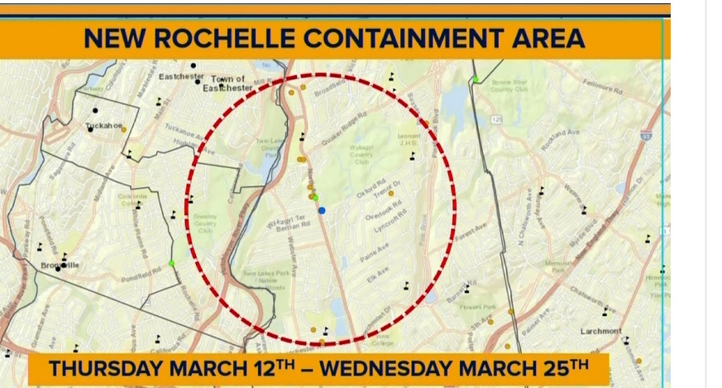
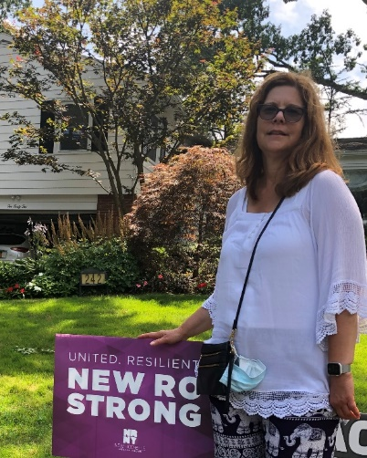
COVID-19 and Home Health
Living and Working in the Containment Zone
Sandra R. Hyman, RN, MPA,CIC, FAPIC
Director of Patient Services, Lawrence Home Care of Westchester
914 787-6158
sah9023@nyp.org

Slide 2
Key Changes That Influenced Patient Care
LHCW Serves Westchester County and Early March – 1st case identified in NYS. Containment Zone Created in New Rochelle. PPE Shortage for Certified Home Health Agencies (CHHAs)
CMS Exceptions; Telemedicine and Expansion of Practice Location Starting seeing COVID-19 + patients April 19th. Criteria developed for admission.
May – Increase in COVID-19 patients for Home Care and Hospice
June –Guidelines updated for Discontinuation of Home Isolation. Resumption of Surgical Cases.
July –Guidelines updated for Discontinuation of Home Isolation. In creases in Surgical Cases.

Slide 3
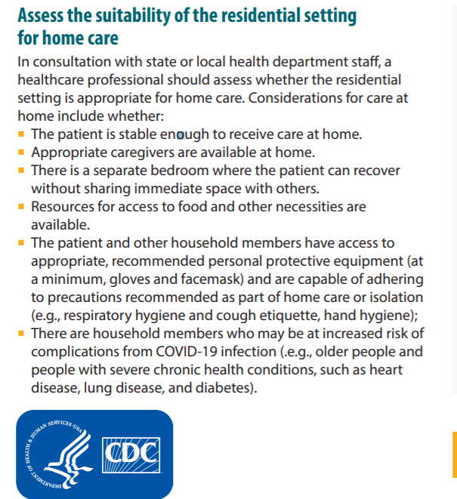
Assess Home Care Setting Prior to Discharge
COVID+ Family Members

Slide 4




Sources for Policies /Guidelines
NewYork-Presbyterian
Home Care Association (HCA)
NYS Dept. of Health
CDC
Joint Commission

Slide 5
COVID-19 Kits that Suport Patient Care
Kits Contain the Following:
Supplied at Discharge as Needed:
Gowns
Gloves
Face shield or Goggles (Received by Mid June)
Surgical Masks
Stethoscope*
Thermometer*
Sphygmomanometer*
items are left in home*
Oxygen
Pulse Oximeter

Slide 6



Challenges in Home Care

Slide 7
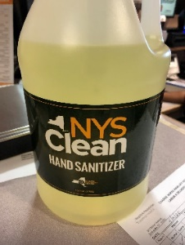
NYS DOH Role in PPE Supply
NYS DOH Requires a Certified Home Health Agency (CHHA) HERDS 3/24-6/10 daily 6/12-Present 3 times/week Assessment of PPE supply
Patient Census
Patient Level;1- 3
Deaths
Hours providing care of Nursing/Home Health Aides
NYS DOH Provides PPE and Hand Sanitizer Through the Emergency Management Program
Offer NYS Clean Hand Sanitizer in Large Containers
  Poured sanitizer in Peri Bottles
Our Primary Source of Supplies is Hospital
  Disinfectant Wipes Put In Plastic Bags
  Supplies not designed for Community Health

Slide 8
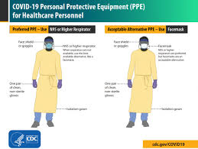
DDDonning and Doffing
Donning is Performed Prior to Entry
Ill Family Members are asked to Isolate in another Room
Recommend No Visitors
Request a Mask be Worn by
Patient and Family Members
Doffing is performed Outside the Home
Plastic Bag With Used PPE is Left Outside the Home Tied Up and asked to be Removed by Patient and or Family Member

Slide 9


Slide 10
DiDiscontinuation of Isolation
Guidelines Have Changed Multiple Times
CDC Provides Guidance for Discontinuation
Discontinuation based on time and symptoms
  10 days since onset of symptoms or positive PCR , if asymptomatic
  immunocompromised patients must maintain isolation for a minimum
  of 20 days
  At least 24 hours with no fever, without use of antipyretics, AND
  Marked improvement in symptoms, if present (e.g. cough, shortness
  of breath

