Slide 1
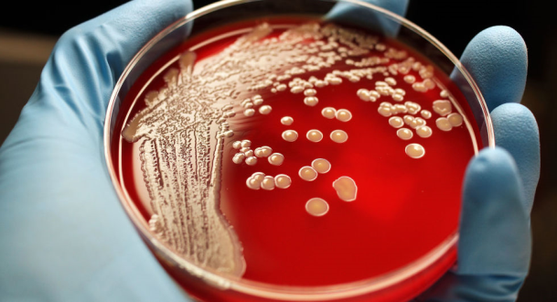
MRSA
Regina Livshits RN MSN
NYU Langone Medical Center
regina.livshits@nyumc.org
212-263-5454

Slide 2
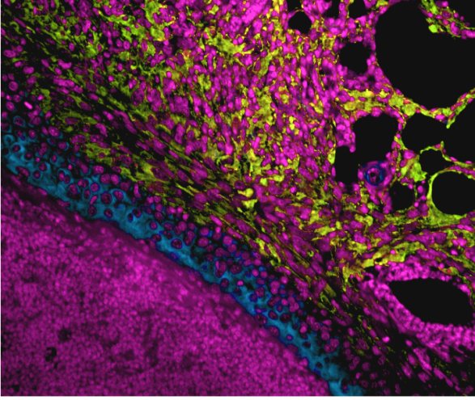
MRSA
Methicillin-resistant Staphylococcus aureus (MRSA)
Common bacteria in the nose and on the skin of people and animals
Causes invasive infections of multiple body sites
Superbug – MRSA strains are resistant to many different antibiotics
Common cause of HAI and community-acquired infections
MRSA colonization most important risk factor for invasive MRSA infection
  Who is at Risk for MRSA infection
  Newborns
  Women who are breastfeeding
  Diabetes
  Vascular or lung disease
  Cancer

Slide 3
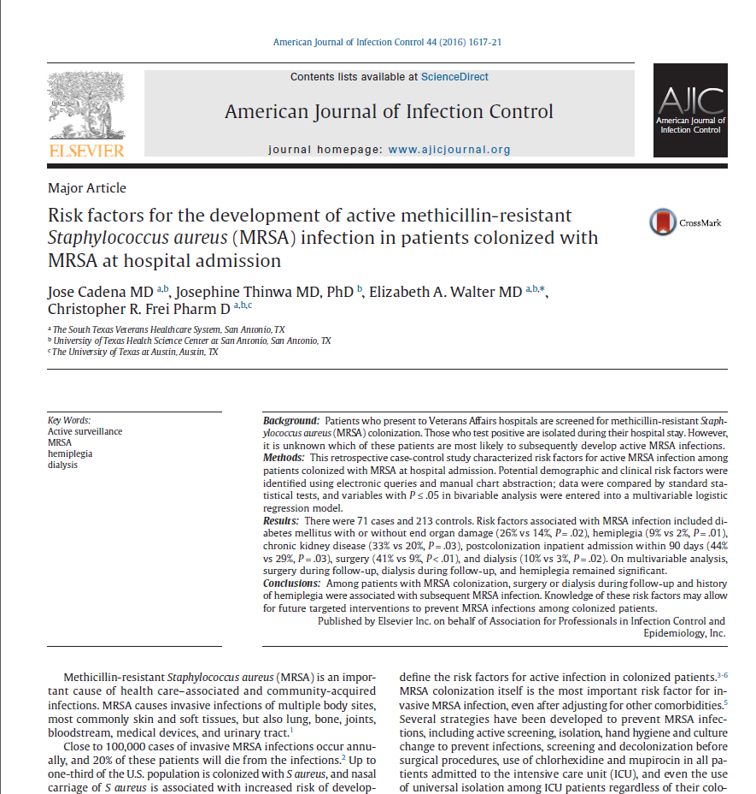
AJIC December 2016 -- pp 1617-1621

Slide 4
Retrospective case-control matched study
Study for 2 years -- 09/01/2009 - 08/31/2011
+ Colonized MRSA patients on acute admission who developed MRSA invasive infections; did not include pts admitted to LTCF at the VA
follow up period once patient developed invasive disease (excluding pneumonia) for up to 18 months
Controls: patients who didn’t develop active MRSA for up to 18 months
Statistical analysis – performed using JMP statistical software

Slide 5
Results
71 cases and 213 controls
Most body sites affected -- soft tissues, lungs, and urinary tract
No significant association between antibiotic use and MRSA infection
Significant risk factors for development invasive MRSA
  Diabetes mellitus with organ damage
  Chronic kidney disease
  Readmission 90 days post discharge
  Prior inpatient admission in 12 months
  Medical hx of hemiplegia*
  Surgery post-colonization*
  Dialysis post-colonization*
  * significant on multivariate analysis

Slide 6
Discussion
No universal agreement for preventing invasive MRSA
Some try “horizontal approach” – hand hygiene, central line bundles
Some try “vertical approach” – screening and decolonization
Some try “both strategies”
What do you do?

Slide 7
Comparison Studies From Other VA Centers
VA Pittsburgh
Risk factors for MRSA infection
  hospitalized or within 30 days of discharge
  prior Hx of MRSA colonization within 1 year
  Transfer from nursing home
  Respiratory failure
  Transfusion
Limitation – 44% of LTCF patients were colonized and short follow up period
Notes:
This studies had very interesting results for example VA Pittsburgh

Slide 8
Comparison Studies From Other VA Centers
VA in Iowa City:
Assessed long term outcomes of MRSA colonization
There were no culture-proven MRSA on readmission among non-carriers
13% of MRSA carriers were readmitted with culture proven MRSA infection
Mortality was significantly higher among MRSA carriers than non-carriers

Slide 9
Additional Comparison Studies
Other studies show hemiplegia and dementia are risk factors for MRSA colonization but this study was first to show hemiplegia is risk for MRSA infection
S. Aureus decolonization before surgery is associated with a decreased rate of S. Aureus surgical site infection
Study in Scotland- found decrease antibiotic pressure can lead to fewer invasive MRSA infection
Notes:
MRSA colonization may have stroke patients have worse recovery, prolonged length of rehab stay, and increase mortality.

Slide 10
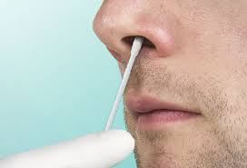
Additional Comparison Studies
Dialysis patients
  Decolonization attempts have limited success
  Patients who failed decolonization have higher risk for bacteremia
  Successful decolonization with mupirocin was associated with 82 % (one study) and 88 % (in another study) decrease in blood stream infection

Slide 11
Limitations
Retrospective design
Selection bias
VA population
Probably no antibiotic stewardship program
Small study
One hospital

Slide 12
