Slide 1

Education
Advocacy
Support
Barbara Smith RN, BSN, MPA, CIC, FAPIC – Mount Sinai St. Luke’s/ Mount Sinai West

Slide 2

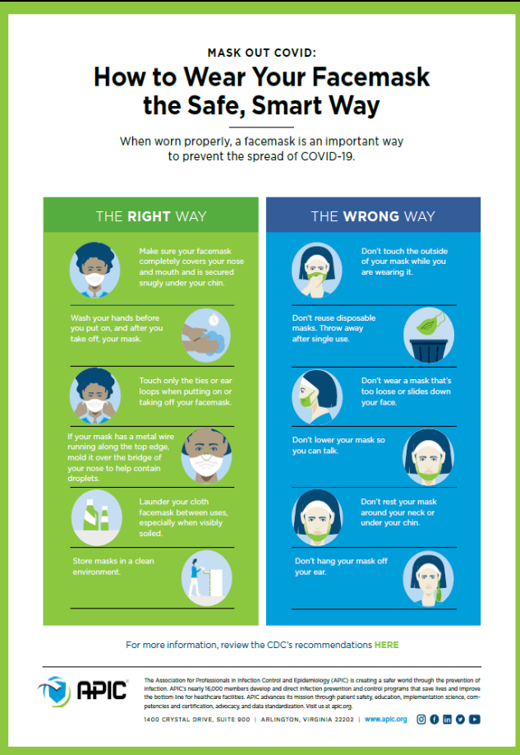

Education
Ow.ly/6Cic50AQQXn

Slide 3
Education
Town Halls
3/30/20 ANA- APIC Be Confident Protecting Yourself and Providing the Best Care to Your Patients during this COVID-19 Pandemic - On Demand
8/20/2020 – Managing COVID in LTC
7/30/2020 – COVID 19 Transmission routes including AGP
Plus upcoming ones on
Out of hospital care,
PPE reuse and cleaning
Live from Industry: Re-emerging from the COVID-19 Pandemic: Strategies for Patient and Healthcare Worker Safety During Challenging Times
September 9, 2020 @ 1 pm ET
APIC TEXT ONLINE
If you're not yet a subscriber, we hope you'll take advantage of our offer of free content during the COVID-19 pandemic. We’ve made two of our Chapter Collections, Long-Term Care and Outbreak Preparedness and Response, available for free to everyone through September 30. These Collections comprise 34 chapters from the APIC Text, including several that you may find especially relevant to the current situation, such as Hand Hygiene; Standard Precautions; Cleaning, Disinfection, and Sterilization; and Environmental Services.

Slide 4
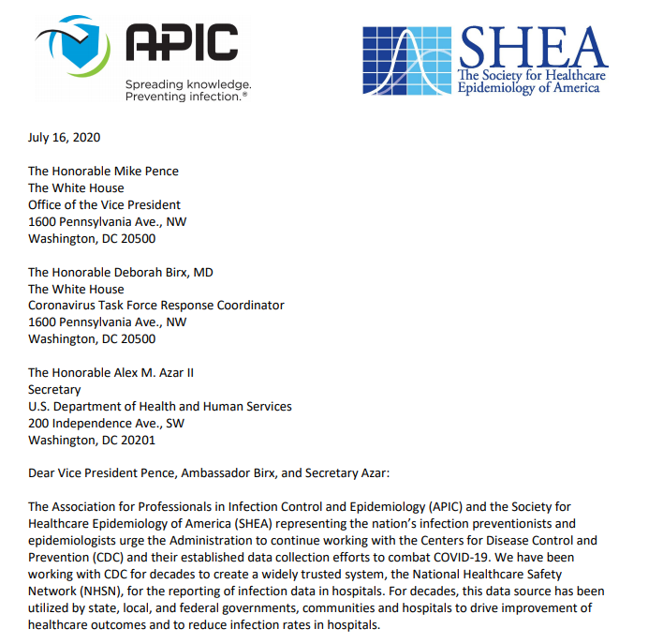
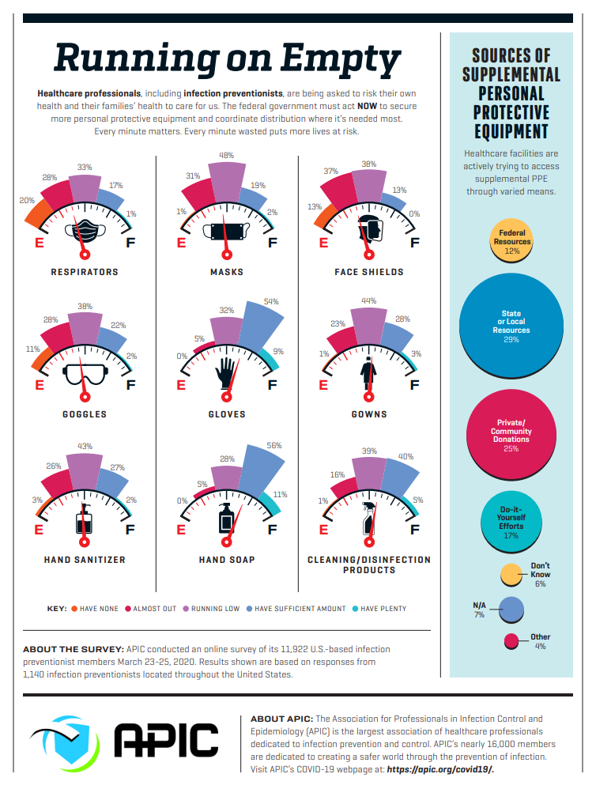
Advocacy
APIC Denounces Changes to
COVID-19 Data Reporting

Slide 5
Support
8/21/2020 – Fostering Resilience in Healthcare Workers Affected by the COVID-19 Pandemic
CALM app
Chapter support and out reach

Slide 6
Literature
Who has anything to share
Send me your published articles
barbaraA.smith@mountsinai.org

Slide 7
APIC Annual Survey deadline 9/18/20
If you need assistance with the survey, please contact Meghana Deshmane, Senior Research Associate at McKinley Advisors, by emailing mdeshmane@mckinley-advisors.com. If you have any questions about APIC's process or how the data will be used, please contact Sara Miller, APIC's Senior Director – Membership, by emailing smiller@apic.org.

