Slide 1
Journal Club Presentation
APIC Greater NY Chapter 13
12.17.14
Faith Skeete, MS RN CIC

Slide 2
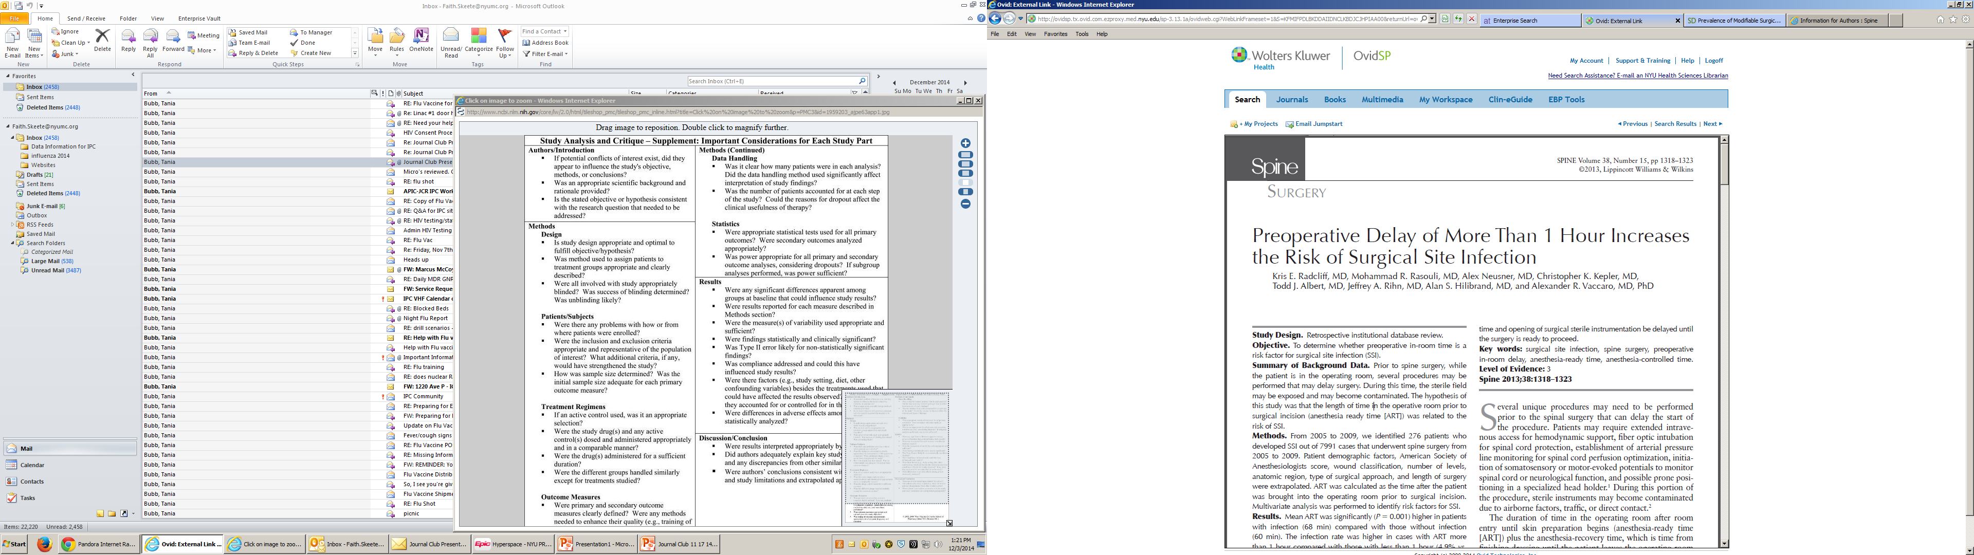
Peer Reviewed Journal Article

Slide 3
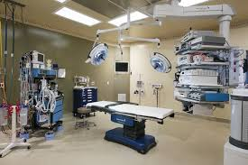
Main Objective
‘To determine whether preoperative in-room time is a risk factor for surgical site infection (SSI).’

Slide 4
Purpose
To determine whether preoperative in-room time is a risk factor for surgical site infection (SSI).
To determine the threshold time beyond which the infection risk is increased.

Slide 5

Design
Retrospective institutional database review

Slide 6
Methods
Case finding (2005-2009):
  Review of all consecutive spine surgeries for positive microbiology cultures
  Review of readmissions and reoperations

Slide 7
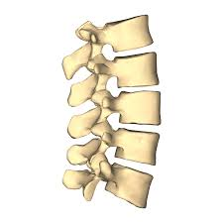
Methods
CDC SSI definition

Slide 8
Methods
All spine surgeries
  n= 9259
All spine surgeries without pre-existing infections
  n= 7991

Slide 9
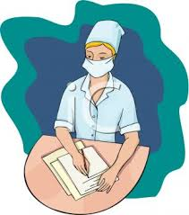
Methods
Nursing documentation:
  In-room
  Incision
  Closure
  Out-of -room

Slide 10
Methods (Group Comparison)
Univariate Analysis
Student t test
  X² (Fischer exact test)
Multivariate Analysis:
  Pearson
  Spearman

Slide 11
Results
All cases = 7991
Infected = 276 (rate = 3.4)
Not infected = 7715
<1hr = 2.3
p < 0.001
>1hr = 4.9

Slide 12
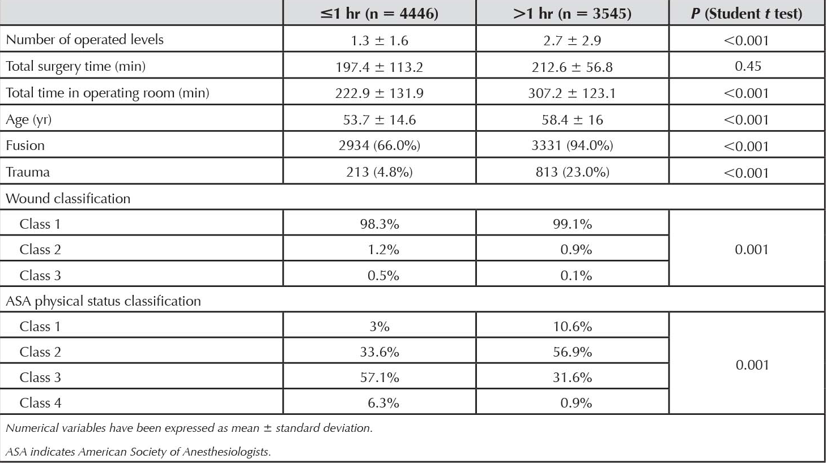
Results:
Predictors of ART

Slide 13
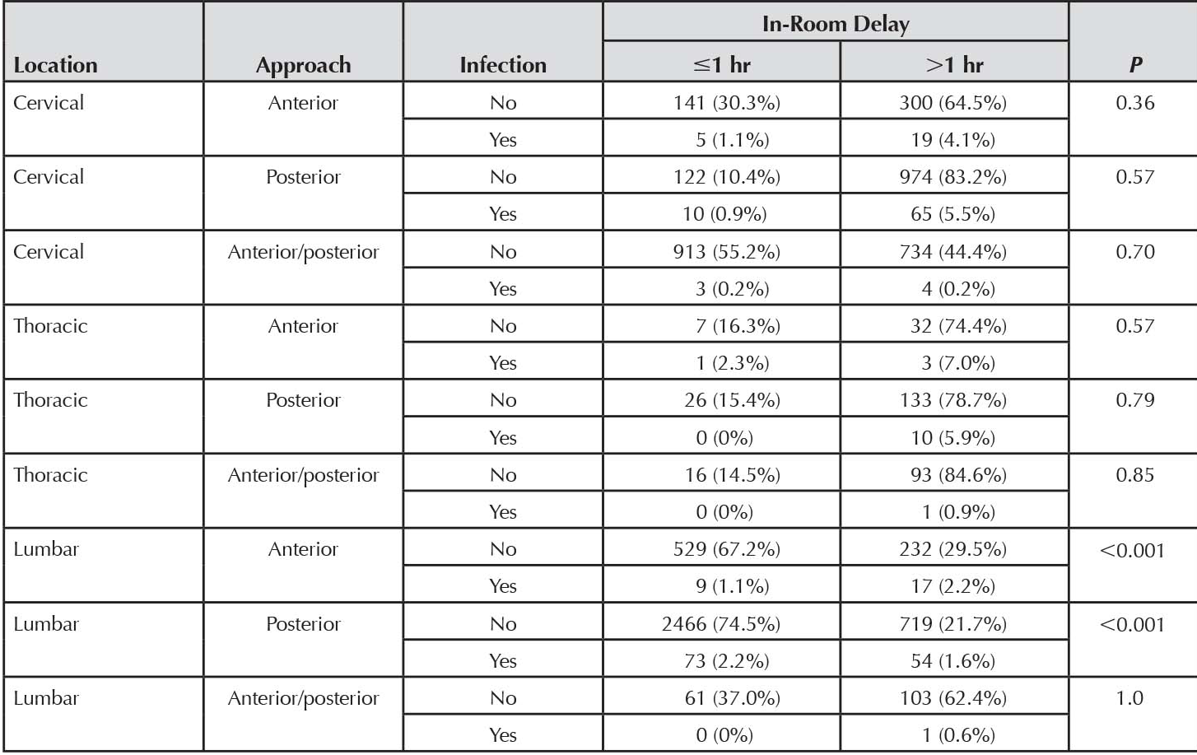
Results:
Predictors of ART

Slide 14
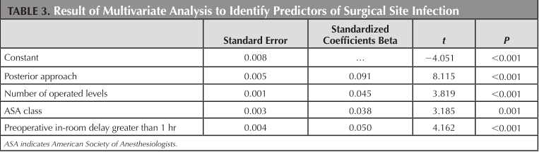
Conclusion
‘Preoperative in-room time prior to the start of surgical incision is an independent risk factor for SSI.’

Slide 15
Discussion
Were the results valid?
What were the strengths and weaknesses of the study?
What are the next steps?

