Slide 1
Journal Club
APIC Greater NY Chapter 13
Kalani Thaler, MPH, CIC
March 20, 2024

Slide 2
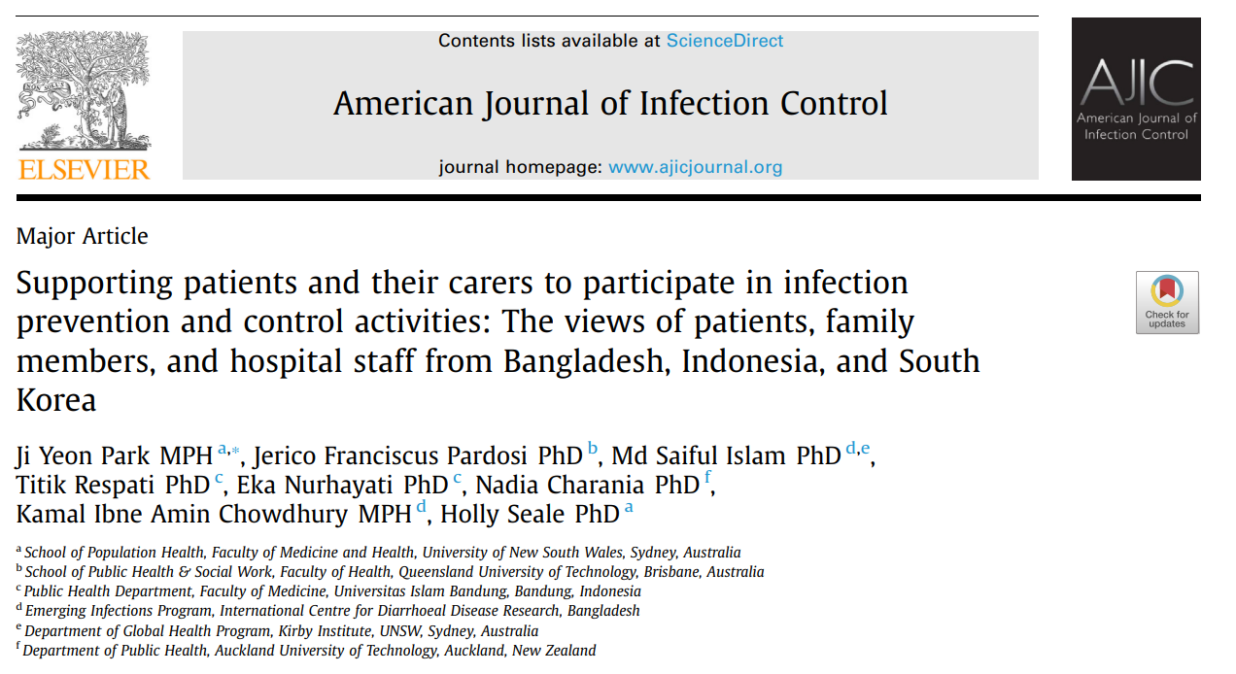
Article Overview
Notes:
My inspiration for sharing this article: NYS DOH Health Notification for NYS DOH had a grand grounds recently around the State Master Plan for Aging that discussed “aging in place” and the mission to meet health and long term care needs to promote aging in place; there’s a lot of priority around preventing chronic disease, communicable diseases and overall well being promotion
Aside from aging population, care takers are vital component of a patient’s care continuum

Slide 3

Study Design
Setting:5 tertiary-level hospitals in Bangladesh, Indonesia, and South Korea; 64 participants interviewed in 57 interviews, including 6 group interviews. All interviews conducted July 2019 – February 2020.
Objective: Identify barriers to engaging patients and family caregivers in IPC measures; Provide a comprehensive exploration of IPC empowerment within the context of family involvement in care provision
Inclusion: patients and their family and private carers; HCWs
Photo credit: Women in Global Health
Notes:
These countries were selected as they: (1) refect examples of the spectrum of socio-economic countries in Asia, lowincome countries (LIC), middle-income countries (MIC), and high-income countries (HIC); (2) are known to have a culture of family members providing care; and (3) had local researchers who could undertake the interviews in the language(s), and who understood and had access to the hospital settings.

Slide 4
Methods
Participants:
  3 groups of participants: (1) patients who were hospitalized for a minimum of 2 days and who had a family or private carers present with them; (2) family and private carers who had provided care for at least 5 hours at the clinical setting; and (3) HCWs who had worked at least 1 month at the hospital.
  Data were collected from 5 tertiary-level hospitals across 3 selected countries in Asia: Dhaka in Bangladesh, West Java province in Indonesia, and Gyeonggi-do province in South Korea. All interviews were conducted between July 2019 and February 2020
Data Collection:
  Semi-structured interviews were undertaken with two different groups: Group 1- Patients, family carers and private carers; and Group 2- healthcare workers, including nurses, doctors, hospital managers and staff members responsible for implementing infection control strategies
  Interview length ranged from 17-55 minutes and were audio-recorded for the purpose of analysis​
Data Analysis:
  NVivo 12 was used for coding and data management. Drawing upon the principles of grounded theory, thematic analysis using an inductive approach was applied to identify themes
  Data were analyzed following the 6 phases of reflexive thematic analysis: (1) familiarizing yourself with the data, (2) generating initial codes, (3) constructing prototype themes, (4) reviewing themes, (5) defining and naming themes, and (6) producing the report.
Notes:
Froom article:
Recruitment This study utilised a range of sampling approaches, including both convenience and purposeful, as well as snowball recruitment. Convenience sampling was frst applied to identify study sites that could provide access to the diferent groups of participants [29]. Once the study sites were confrmed, purposeful sampling was applied to recruit the study participants. During the data collection, the existing participants were asked to alert other patients, family members and private carers in the same ward about the study. Tus the snowball technique occurred. Te snowball method was also used to identify other HCWs for the interviews. Participant recruitment continued until the researchers felt there were no new ideas or new issues raised and felt the data saturation was reached
The interviews with the participants from group 1 were conducted either at the patient’s bedside or in an empty patient room available as per their preference and availability. Interviews with the participants in group 2 were done in various locations such as an empty staf room, a café in a lobby, a vacant manager’s ofce or a patient room depending on the availability. Some of the interviews were done in a group setting, i.e., a patient and their family carer or two healthcare workers together, often because of time constraints. All interviews were conducted in participants’ native languages

Slide 5






Results
Bangladesh x20
Indonesia x19
South Korea x25
Total participants: 64
HCW x27
Patient x16
Carer x21
Photo credit: Flags: The World Factbook 2021. Washington, DC: Central Intelligence Agency, 2021.; Person figures: iStock

Slide 6
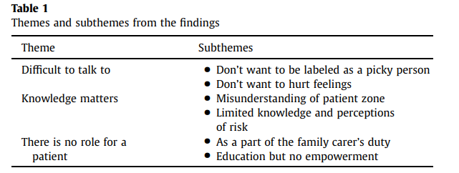
Results continued
3 main themes and 6 subthemes
Factors that influence IPC empowerment: concerns related to potential disadvantages and repercussions stemming from hierarchical relationships between doctors and patients, a lack of knowledge about HAI and IPC measures, the interdependent relationship between HCWs and family or private carers, IPC measures considered as a barrier to family connections, misunderstanding of the patient zone, and patients’ nonassertive attitude toward IPC empowerment
Notes:
irrespective of resource availability
In contrast to previous studies that primarily focused on the patients’ perspectives and challenges in communicating their concerns to HCWs, our study reveals a novel finding. We discovered that patients encounter similar challenges when attempting to exercise empowerment and voice their concerns about IPC measures to their families and private carers. This finding is particularly significant considering the substantial involvement of family carers in providing inpatient care, which is prevalent in many Asian countries. In line with our previous research,21,31 which extensively examined the extensive participation of family carers in care provision within tertiarylevel hospitals, our findings underscore the significant role played by family carers in conducting various care activities within the patient room. Consequently, due to the established caregiver-recipient relationship, patients may feel uncomfortable discussing IPC practice directly with their family carers. This relationship dynamic creates a barrier to open communication about IPC concerns, resembling the dynamic observed between HCWs and patients.

Slide 7
Conclusion
Maintaining the family bond: While patients reported the fear of negative consequences in their care was the main reason for their nonassertive attitudes toward HCWs, the primary reason for patients’ hesitancy to speak up toward family carers was the concern of damaging family relationships or disconnection among family members
  In the study, many participants indicated that patients became passive care recipients while their family carers acted on their behalf. This is concerning because IPC empowerment is intended to actively engage patients at the center of their care.
  This unique relationship has been developed as a consequence of several factors, which are: (1) family carers are considered as a supplement staff under the shortage of nursing workforce, which has shaped the provision of patient care, (2) family carers function as an unrecognized informal workforce, are operating without any policies and guidelines to govern their roles, and (3) cultural norms surrounding the care of sick family members further contribute to this dynamic.
Acquisition of necessary knowledge to engage with health care providers is fundamental to empowerment
Notes:
Key take aways: Fear, Family Bond, acquisition of the necessary knowledge
This finding is particularly significant considering the substantial involvement of family carers in providing inpatient care, which is prevalent in many Asian countries. In line with our previous research,21,31 which extensively examined the extensive participation of family carers in care provision within tertiarylevel hospitals, our findings underscore the significant role played by family carers in conducting various care activities within the patient room
due to the established caregiver-recipient relationship, patients may feel uncomfortable discussing IPC practice directly with their family carers; barrier to open communication
This lack of education can be attributed, in part, to HCWs’ heavy workloads. Unfortunately, we did not explore the extent to which HCWs themselves received education or instruction regarding IPC measures and empowerment. Lack of knowledge among patients, carers, and HCWs can indeed reflect a lack of instruction, which has important implications for IPC empowerment.
primary reason for their hesitancy to speak up toward family carers was the concern of damaging family relationships or disconnection among family members.

Slide 8
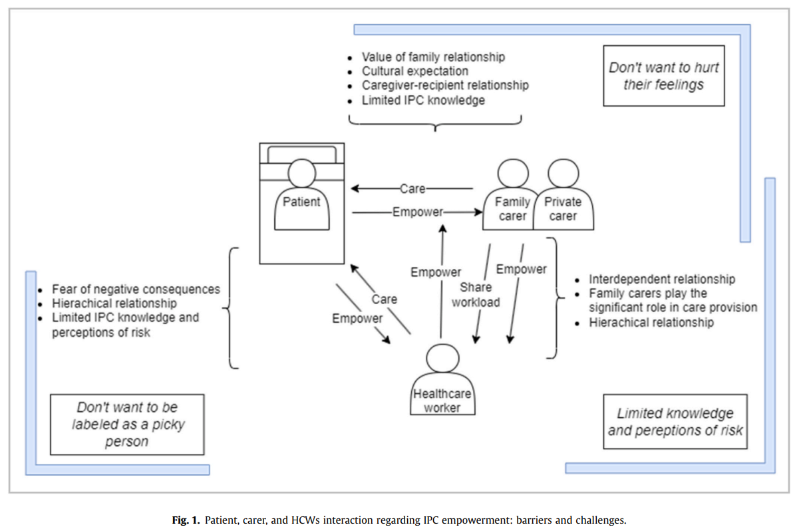
Conclusion continued

Slide 9

Discussion
Cultural beliefs, attitudes, and traditions play a significant role in shaping behaviors related to infection prevention and control. Tailoring IPC interventions to specific cultural contexts can help mitigate the barriers identified in this study.
Questions:
How does patient and caregiver empowerment play into your infection control program?
Are there any patient/caregiver education in place at your facility (e.g., HAIs, hand hygiene, CVAD maintenance at home)?
How do you enforce IPC practices (e.g., PPE compliance and hand hygiene) among visitors?
Photo credit: iStock

