Slide 1
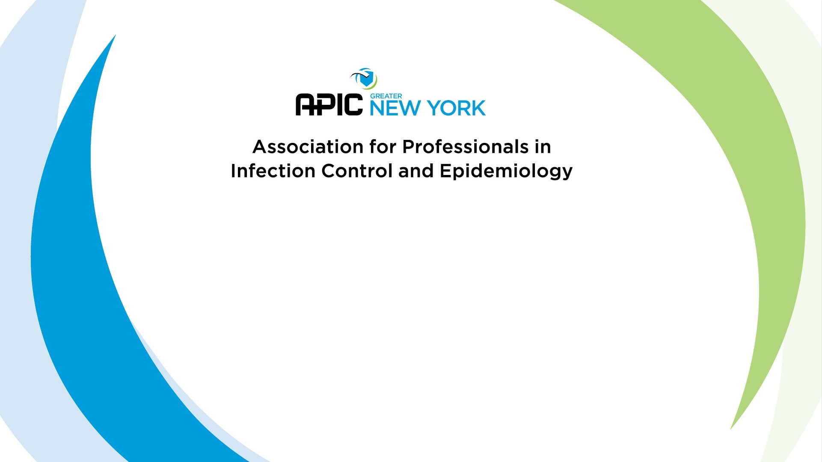
Preparing for Certification
D. Kyle Willey, BS CIC

Slide 2
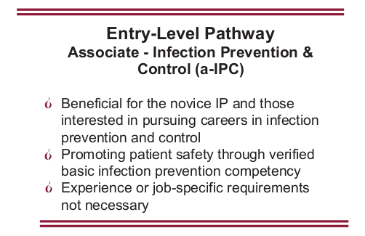
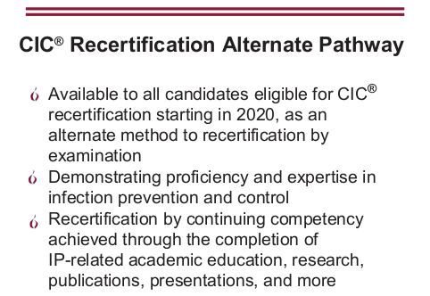
News! – New Certification Initiatives

Slide 3
What is on the Exam?
Identification of Infectious Disease Processes (22 items)
  Interpret diagnostic and laboratory reports
  Practices for specimen collection, handling, and storage
  Correlate clinical s/s with infectious disease processes
  Differentiate colonization, infection, and contamination
  Differentiate prophylactic, empiric, and therapeutic uses of antimicrobials

Slide 4
What is on the Exam?
Surveillance and Epidemiologic Investigation (24 items)
  Design of Surveillance Systems
  Collection and Compilation of Surveillance Data
  Interpretation of Surveillance Data
  Outbreak Investigation

Slide 5
What is on the Exam?
Preventing/Controlling the Transmission of Infectious Agents (25 items)
  Develop evidence-based/informed infection prevention and control policies and procedures
  Collaborate with relevant groups and agencies in planning community/facility responses to biologic threats and disasters
  Identify and implement infection prevention and control strategies

Slide 6
What is on the Exam?
Employee/Occupational Health (11 items)
  Develop screening and immunization programs
  Evaluate data and develop work restriction recommendations related to communicable diseases and/or exposures
  Recognize healthcare personnel who may represent a transmission risk to patients, coworkers, and communities
  Assess risk of occupational exposure to infectious diseases (e.g., Mycobacterium tuberculosis, bloodborne pathogens)

Slide 7
What is on the Exam?
Management and Communication (13 items)
  Infection Prevention program planning
  Communication and Feedback
  Evaluate and facilitate compliance with accreditation standards/regulatory requirements
  Quality Performance Improvement and Patient Safety

Slide 8
What is on the Exam?
Education and Research (11 items)
  Education
    Assess needs, develop goals and measurable objectives
    Prepare, present, or coordinate educational content that is appropriate for the audience
  Research
    Conduct a literature review
    Critically appraise the literature
    Facilitate incorporation of applicable research findings into practice

Slide 9
What is on the Exam?
Environment of Care (14 items)
  Elements important for a safe care environment
  Assess infection risks of design, construction, and renovation
  Evaluation and monitoring of environmental cleaning and disinfection
  Selection and evaluation of environmental disinfectant products

Slide 10
What is on the Exam?
Cleaning, Sterilization, Disinfection, Asepsis (15 items)
  Identify and evaluate appropriate cleaning, sterilization and disinfection practices
  Collaborate with others to assess products under evaluation for their ability to be reprocessed
  Identify and evaluate critical steps of cleaning, high level disinfection, and sterilization

Slide 11
1. A hospital is participating in a methicillin-resistant Staphylococcus aureus (MRSA) surveillance initiative, collecting nares cultures on patient admission. Patients transferred from a particular extended-care facility (ECF) have been identified with significantly higher MRSA colonization rates. Which of the following should the infection preventionist (IP) initially recommend?
Sample Test Questions
Contact precautions for patients admitted from the ECF
Notification to other area hospitals
Surveillance culturing without intervention
Communication with the ECF regarding findings
Discussion:
A couple good choices. Any bad ones?
What CDC/State says, not what you might actually do.

Slide 12
2. An infection preventionist (IP) wants to implement targeted surveillance at a facility and is meeting resistance. The IP may do all of the following EXCEPT
Sample Test Questions
document the benefits of this surveillance
include input from others who will use the surveillance data
explain that regulatory agencies require targeted surveillance
contact other hospitals for community and national surveillance standards
Discussion:
What is the least effective option from an Adult Learner standpoint?
Notes:
Must determine main problem prior to education/performance improvement

Slide 13
3a. When a point source outbreak is suspected, which of the following anatomical sites should be cultured when searching for Staphylococcus aureus carriers?
Nose
Hands
Throat
Rectum
Discussion:
Where does this organism colonize?

Slide 14
3b. When a point source outbreak is suspected, which of the following anatomical sites should be cultured when searching for VRE carriers?
Nose
Hands
Throat
Rectum
Discussion:
Where does this organism colonize?

Slide 15
3c. When a point source outbreak is suspected, which of the following anatomical sites should be cultured when searching for Candida auris carriers?
Nose
Axilla
Throat
Groin
Discussion:
Where does this organism colonize?

Slide 16
4. Which of the following viruses has been associated with the HIGHEST rate of transmission among infants in neonatal nursery settings?
Sample Test Questions
Discussion:
How are each transmitted?
What risk factors are involved?
herpes simplex virus
cytomegalovirus (CMV)
Coxsackievirus
respiratory syncytial virus
Notes:
Blood/Body Fluid exposures on A, C, D

Slide 17
5. A case of which of the following situations warrants immediate investigation by the infection preventionist (IP)?
Sample Test Questions
H. influenza pneumonia in a patient in the Medical Unit
conjunctivitis in a patient following eye surgery
Legionella pneumonia in a patient in the Oncology Unit
norovirus in a patient in the Emergency Department
Discussion:
All require attention, what is MOST IMMEDIATE?
Can we rule out any?

Slide 18
6. An infection preventionist (IP) is developing a post-discharge surveillance program for surgical site infections. A review of the literature on the subject should indicate which of the following?
Sample Test Questions
There are published standard methods for conducting post-discharge surveillance.
More than 50% of surgical site infections may be missed without a formal post-discharge surveillance system in place.
Post-discharge surveillance that solicits direct feedback from patients yields data with the best specificity and sensitivity to identify true infection.
The trend of shorter length of stay has not significantly impacted the rate of surgical site infections identified through inpatient surveillance programs.
Discussion:
What risk factors are involved?

Slide 19
7. An infection preventionist (IP) noted an increase in sternal surgical site infections (SSIs) following CABG procedures performed in the IP's facility during the past four quarters. Which of the following should be reviewed by the IP in conjunction with the interdisciplinary team?
Sample Test Questions
infusion of vancomycin mean duration = 90 minutes
discontinuation of antibiotics 24 hours after surgery
mean glucose readings 6 AM day 2 postoperative = 120 mg/dL (6.7 mmol/L)
shaving the site 1 hour before surgery
Discussion:
Are there any we can exclude?
What is correct for these?
These all used to be the SCIP measures – we stopped measuring in 2014 or so.

Slide 20
8. Which of the following can contribute to a foodborne illness outbreak?
Sample Test Questions
using non-pasteurized eggs in salad dressing
washing cutting boards after preparing raw chicken
refrigerating unused food within 2 hours of preparation
rinsing raw vegetables before use
Discussion:
Are there any we know that we can exclude?

Slide 21
8 (Follow-up). Which foodborne illness outbreaks of the following are most attributed to?
Sample Test Questions
Using non-pasteurized eggs in salad dressing
Rinsing raw chicken prior to preparation
Not rinsing raw vegetables
Can openers
Deli slicers
Salmonella
Salmonella, Campylobacter, C. perfringens, E.coli
Hepatitis A, E.coli, Listeria
Mold, yeast, E.coli
Listeria – 3rd highest deaths

Slide 22

Notes:
References
1. Association for Professionals in Infection Control and Epidemiology. (2015). Certification Study Guide, 6th edition. Arlington: Association for Professionals in Infection Control and Epidemiology.
2. Association for Professionals in Infection Control and Epidemiology, Inc. (2015). APIC Text of Infection Control and Epidemiology. Arlington, VA.
3. Certification Board of Infection Control and Epidemiology, Inc. (2016, June). Certification in Infection Prevention and Control (CIC). Milwaukee, Wisconsin. Retrieved from https://view.officeapps.live.com/op/view.aspx?src=https://www.cbic.org/UserFiles/file/UnderstandingCBICandtheCICCredential-2018-longversion.ppt
4. Certification Board of Infection Control and Epidemiology, Inc. (2018). CBIC Certification Website. Retrieved 10 1, 2018, from CBIC Website: https://www.cbic.org/certification
5. Krein, S. L., Hofer, T. P., Kowalski, C. P., Olmsted, R. N., Kauffman, C. A., Forman, J. H., et al. (2007). Use of Central Venous Catheter-Related Bloodstream Infection Prevention Practices by US Hospitals. Mayo Clinic Proceedings, 82(6), 672-678.
6. Murphy, D. M., Hanchett, M., Olmsted, R. N., Farber, M. R., Lee, T. B., Haas, J. P., et al. (2012). Competency in infection prevention: A conceptual approach to guide current and future practice. American Journal of Infection Control, 40(4), 269-303.
7. Pogorzelska, M., Stone, P. W., & Larson, E. L. (2012). Certification in infection control matters: Impact of infection control department characteristics and policies on rates of multidrug-resistant infections. American Journal of Infection Control, 40(2), 96-101.
8. Pogorzelska-Maziarz, M., & Kalp, E. L. (2017). Infection prevention outside of the acute care setting: Results from the MegaSurvey of infection preventionists. American Journal of Infection Control, 45(6), 597-602.
9. Saint, S., Greene, M. T., Olmsted, R. N., Chopra, V., Meddings, J., Safdar, N., et al. (2013). Perceived strength of evidence supporting practices to prevent health care-associated infection: Results from a national survey of infection prevention personnel. American Journal of Infection Control, 41, 100-106.
10. Smith, P. W., Bennett, G., Bradley, S., Drinka, P., Lautenbach, E., Marx, J., et al. (2008). SHEA/APIC Guideline: Infection Prevention and Control in the Long-Term Care Facility. Infection Control and Hospital Epidemiology, 29(9), 785-814.
11. The National Association of Directors of Nursing Administration in Long Term Care. (2016). Summary of the New CMS Requirements for Infection Prevention and Control in Long Term Care Settings. The Director, 24(3), 17-23.

