Slide 1
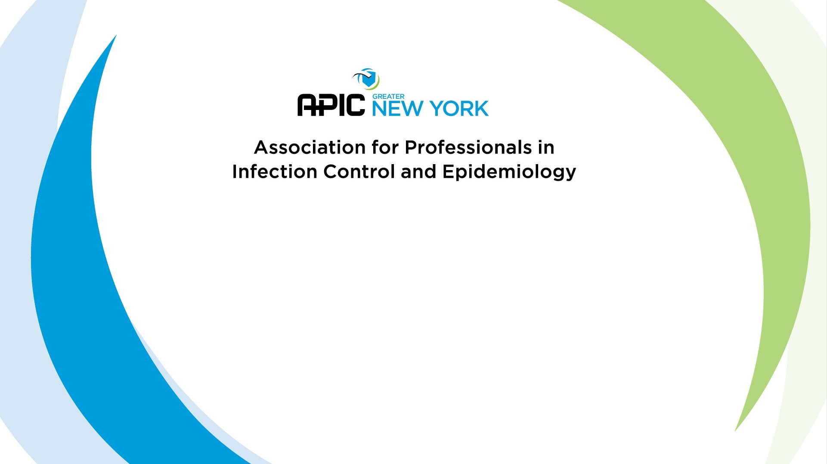
Preparing for Certification
D. Kyle Willey, BS CIC

Slide 2
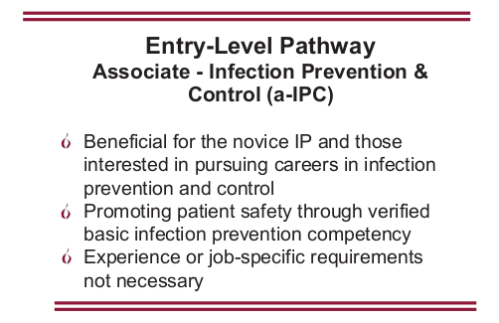
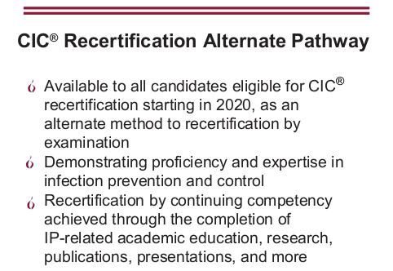
News! – New Certification Initiatives

Slide 3
What is on the Exam?
Identification of Infectious Disease Processes (22 items)
  Interpret diagnostic and laboratory reports
  Practices for specimen collection, handling, and storage
  Correlate clinical s/s with infectious disease processes
  Differentiate colonization, infection, and contamination
  Differentiate prophylactic, empiric, and therapeutic uses of antimicrobials

Slide 4
What is on the Exam?
Surveillance and Epidemiologic Investigation (24 items)
  Design of Surveillance Systems
  Collection and Compilation of Surveillance Data
  Interpretation of Surveillance Data
  Outbreak Investigation

Slide 5
What is on the Exam?
Preventing/Controlling the Transmission of Infectious Agents (25 items)
  Develop evidence-based/informed infection prevention and control policies and procedures
  Collaborate with relevant groups and agencies in planning community/facility responses to biologic threats and disasters
  Identify and implement infection prevention and control strategies

Slide 6
What is on the Exam?
Employee/Occupational Health (11 items)
  Develop screening and immunization programs
  Evaluate data and develop work restriction recommendations related to communicable diseases and/or exposures
  Recognize healthcare personnel who may represent a transmission risk to patients, coworkers, and communities
  Assess risk of occupational exposure to infectious diseases (e.g., Mycobacterium tuberculosis, bloodborne pathogens)

Slide 7
What is on the Exam?
Management and Communication (13 items)
  Infection Prevention program planning
  Communication and Feedback
  Evaluate and facilitate compliance with accreditation standards/regulatory requirements
  Quality Performance Improvement and Patient Safety

Slide 8
What is on the Exam?
Education and Research (11 items)
  Education
    Assess needs, develop goals and measurable objectives
    Prepare, present, or coordinate educational content that is appropriate for the audience
  Research
    Conduct a literature review
    Critically appraise the literature
    Facilitate incorporation of applicable research findings into practice

Slide 9
What is on the Exam?
Environment of Care (14 items)
  Elements important for a safe care environment
  Assess infection risks of design, construction, and renovation
  Evaluation and monitoring of environmental cleaning and disinfection
  Selection and evaluation of environmental disinfectant products

Slide 10
What is on the Exam?
Cleaning, Sterilization, Disinfection, Asepsis (15 items)
  Identify and evaluate appropriate cleaning, sterilization and disinfection practices
  Collaborate with others to assess products under evaluation for their ability to be reprocessed
  Identify and evaluate critical steps of cleaning, high level disinfection, and sterilization

Slide 11
1. A 55-year-old male who is admitted to an emergency department with a high fever and myalgias rapidly develops respiratory distress that requires ventilation. When questioning the family, the Infection Preventionist (IP) learns that the only change in his routine activities was cleaning out an abandoned storage shed near the family home approximately 2 weeks previously. Which of the following infectious diseases MOST likely results in these symptoms?
Sample Test Questions
Hantavirus
Plague
Lyme disease
Q Fever
Discussion:
What are the important clues in the question?
How are each transmitted?
What are the symptoms?

Slide 12
2. A 68-year-old male is admitted for progressive stroke and pneumonia. He has a low-grade fever and had previously been admitted on a bi-monthly basis. He has been diagnosed with Candida esophagitis. Which of the following is the MOST likely underlying condition?
Sample Test Questions
tuberculosis (TB)
chlamydial infection
cytomegalovirus (CMV)
HIV
Discussion:
What symptoms give the best clues?
How do each present as chronic conditions?
Notes:
Must determine main problem prior to education/performance improvement

Slide 13
3. A patient is admitted for aggressive chemotherapy and on hospital day 13, the patient develops high fevers and consolidation on chest x-ray. A chest CT shows left lower lobe patchy infiltrate with dense central consolidation. Which of the following is the most likely cause?
Aspergillus
Legionella
Candida tropicalis
Nocardia asteroids
Discussion:
What factors go into the response?
What are the s/s?
What is the BEST match for unilateral infiltrate?

Slide 14
4. Over a 3 month period, eight patients were diagnosed with Legionella pneumonia. The location of the patients were: 4 in the liver transplant unit, 2 in the trauma unit, and 1 each in the pediatric and psychiatric unit. To control Legionella in this facility, the ICP should:
Sample Test Questions
Discussion:
What is the problem?
Do the different types of units matter?
What risk factors are involved?
Review engineering department’s schedule for changing the HEPA filters
Discontinue the use of the air conditioners on the affected units
Focus surveillance on pediatric and psychiatric units
Culture water supplies from the affected units
Notes:
Blood/Body Fluid exposures on A, C, D

Slide 15
5. A pediatric patient has had erythema of the cheeks for 2 weeks, particularly when in sunlight. A PCR test for B19 DNA is found positive by laboratory study. This child MOST likely has
Sample Test Questions
Lyme disease
Fifth disease
Leprosy
Streptobacillosis
Discussion:
What is the best clue?
What s/s are present?
How do each disease typically present?

Slide 16
6. A patient who has undergone cardiopulmonary resuscitation is subsequently diagnosed as having meningococcal meningitis. Which of the following employees should receive prophylaxis?
Sample Test Questions
anesthetist who performed endotracheal intubation
physician who administered intravenous medications
technician who performed the EKG
nurse who performed chest compressions
Discussion:
Focus on the actions. What risk factors are involved?
Rank the risk from highest to lowest.

Slide 17
7. Which of the following organisms is a spiral-shaped rod associated with gastroenteritis?
Sample Test Questions
Shigella sonnei
Campylobacter jejuni
Escherichia coli
Salmonella enteritidis
Discussion:
Are there any we can exclude?
  One of these things is not like the other. One of these things does not belong…

Slide 18
Follow-up. Which of the following diseases is caused by a spiral-shaped bacterium?
1. Leptospirosis
2. Lyme Disease
3. Relapsing Fever
4. Syphilis
Sample Test Questions
2 and 3
1 and 4
All of the above
None of the above
Discussion:
Are there any we know that we can exclude?
Are there any we know that we can include?

Slide 19

Notes:
References
1. Association for Professionals in Infection Control and Epidemiology. (2015). Certification Study Guide, 6th edition. Arlington: Association for Professionals in Infection Control and Epidemiology.
2. Association for Professionals in Infection Control and Epidemiology, Inc. (2015). APIC Text of Infection Control and Epidemiology. Arlington, VA.
3. Certification Board of Infection Control and Epidemiology, Inc. (2016, June). Certification in Infection Prevention and Control (CIC). Milwaukee, Wisconsin. Retrieved from https://view.officeapps.live.com/op/view.aspx?src=https://www.cbic.org/UserFiles/file/UnderstandingCBICandtheCICCredential-2018-longversion.ppt
4. Certification Board of Infection Control and Epidemiology, Inc. (2018). CBIC Certification Website. Retrieved 10 1, 2018, from CBIC Website: https://www.cbic.org/certification
5. Krein, S. L., Hofer, T. P., Kowalski, C. P., Olmsted, R. N., Kauffman, C. A., Forman, J. H., et al. (2007). Use of Central Venous Catheter-Related Bloodstream Infection Prevention Practices by US Hospitals. Mayo Clinic Proceedings, 82(6), 672-678.
6. Murphy, D. M., Hanchett, M., Olmsted, R. N., Farber, M. R., Lee, T. B., Haas, J. P., et al. (2012). Competency in infection prevention: A conceptual approach to guide current and future practice. American Journal of Infection Control, 40(4), 269-303.
7. Pogorzelska, M., Stone, P. W., & Larson, E. L. (2012). Certification in infection control matters: Impact of infection control department characteristics and policies on rates of multidrug-resistant infections. American Journal of Infection Control, 40(2), 96-101.
8. Pogorzelska-Maziarz, M., & Kalp, E. L. (2017). Infection prevention outside of the acute care setting: Results from the MegaSurvey of infection preventionists. American Journal of Infection Control, 45(6), 597-602.
9. Saint, S., Greene, M. T., Olmsted, R. N., Chopra, V., Meddings, J., Safdar, N., et al. (2013). Perceived strength of evidence supporting practices to prevent health care-associated infection: Results from a national survey of infection prevention personnel. American Journal of Infection Control, 41, 100-106.
10. Smith, P. W., Bennett, G., Bradley, S., Drinka, P., Lautenbach, E., Marx, J., et al. (2008). SHEA/APIC Guideline: Infection Prevention and Control in the Long-Term Care Facility. Infection Control and Hospital Epidemiology, 29(9), 785-814.
11. The National Association of Directors of Nursing Administration in Long Term Care. (2016). Summary of the New CMS Requirements for Infection Prevention and Control in Long Term Care Settings. The Director, 24(3), 17-23.

