Slide 1
Hurricane Sandy
The NYHHS Experience
Presented by
Deborah Hirsch-Temple RN MA
Elizabeth Maccario RN BSN CIC

Slide 2
Friday October 26th 2012
3 Days before Sandy Hits
Storm identified on radar as heading for NYC
In 1992 during a massive Nor'easter the back parking lot was flooded. Back up generators damaged from that event.
Based on the 1992 experience and Irene in 2011 the following was done:
  Incident Command Center opened.
  Director decided to cancel all elective surgery (CV, Neurosurgery etc.)
  Planning for possible evacuation began.

Slide 3
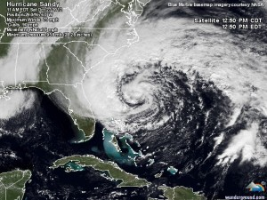
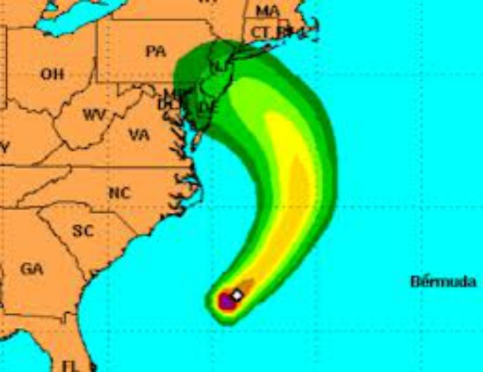
Saturday
October 27th 2012
11am

Slide 4
Saturday October 27th 2012
Saturday Evening all Incident Command Center members were notified to come into the NY Campus on Sunday at 7:30am to possibly evacuate patients.
  ICM is the Liason Officer for the NY campus.
EMS notified as well as private ambulances to come to the NY Campus by 8:30am

Slide 5
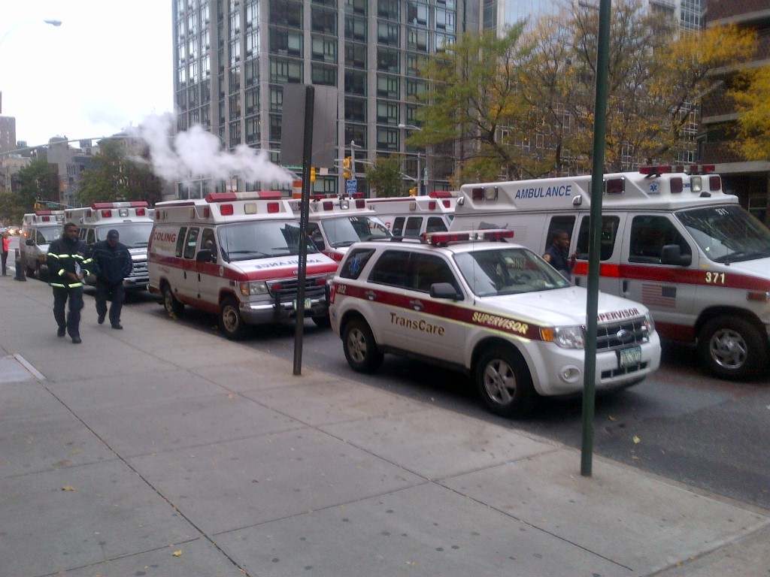
Sunday October 28th 2012

Slide 6
Sunday October 28th 2012
Director decided to evacuate patients at 8:30am and not wait until NYC recommended evacuation of Zone A.
1:30pm Mayor Bloomberg announced that all of Zone A should evacuate by 7pm 10/28/12. NYU and Bellevue didn’t evacuate.
  NYHHS was ½ way completed with the evacuation of 125 patients and 25 mental health patients by 1:30pm.
  5:30pm all patients were evacuated from the NYVAHHS and sent to the BKVA, BXVA and Montrose VAMC.
  No fatalities or injuries occurred from the evacuation

Slide 7
Evacuation Process
Used our electronic Bed Board System with an Excel Spreadsheet.
System enabled us to identify patients needing isolation, special needs(vents, drips, mobility issues, etc.)
System also tracked what VA they were being transferred to.
Electronic Medical Record followed the patient to other VA’s.
It also specified what classification of ambulance(ALS or BLS) was needed for each patient.

Slide 8
Monday October 29th 2012
Sandy Hits!
15 ft wall of water hit the hospital. Pushed out metal doors from hinges.
Roaring water came into the ground floor of the building. A total of 6ft of water in an instant.

Slide 9
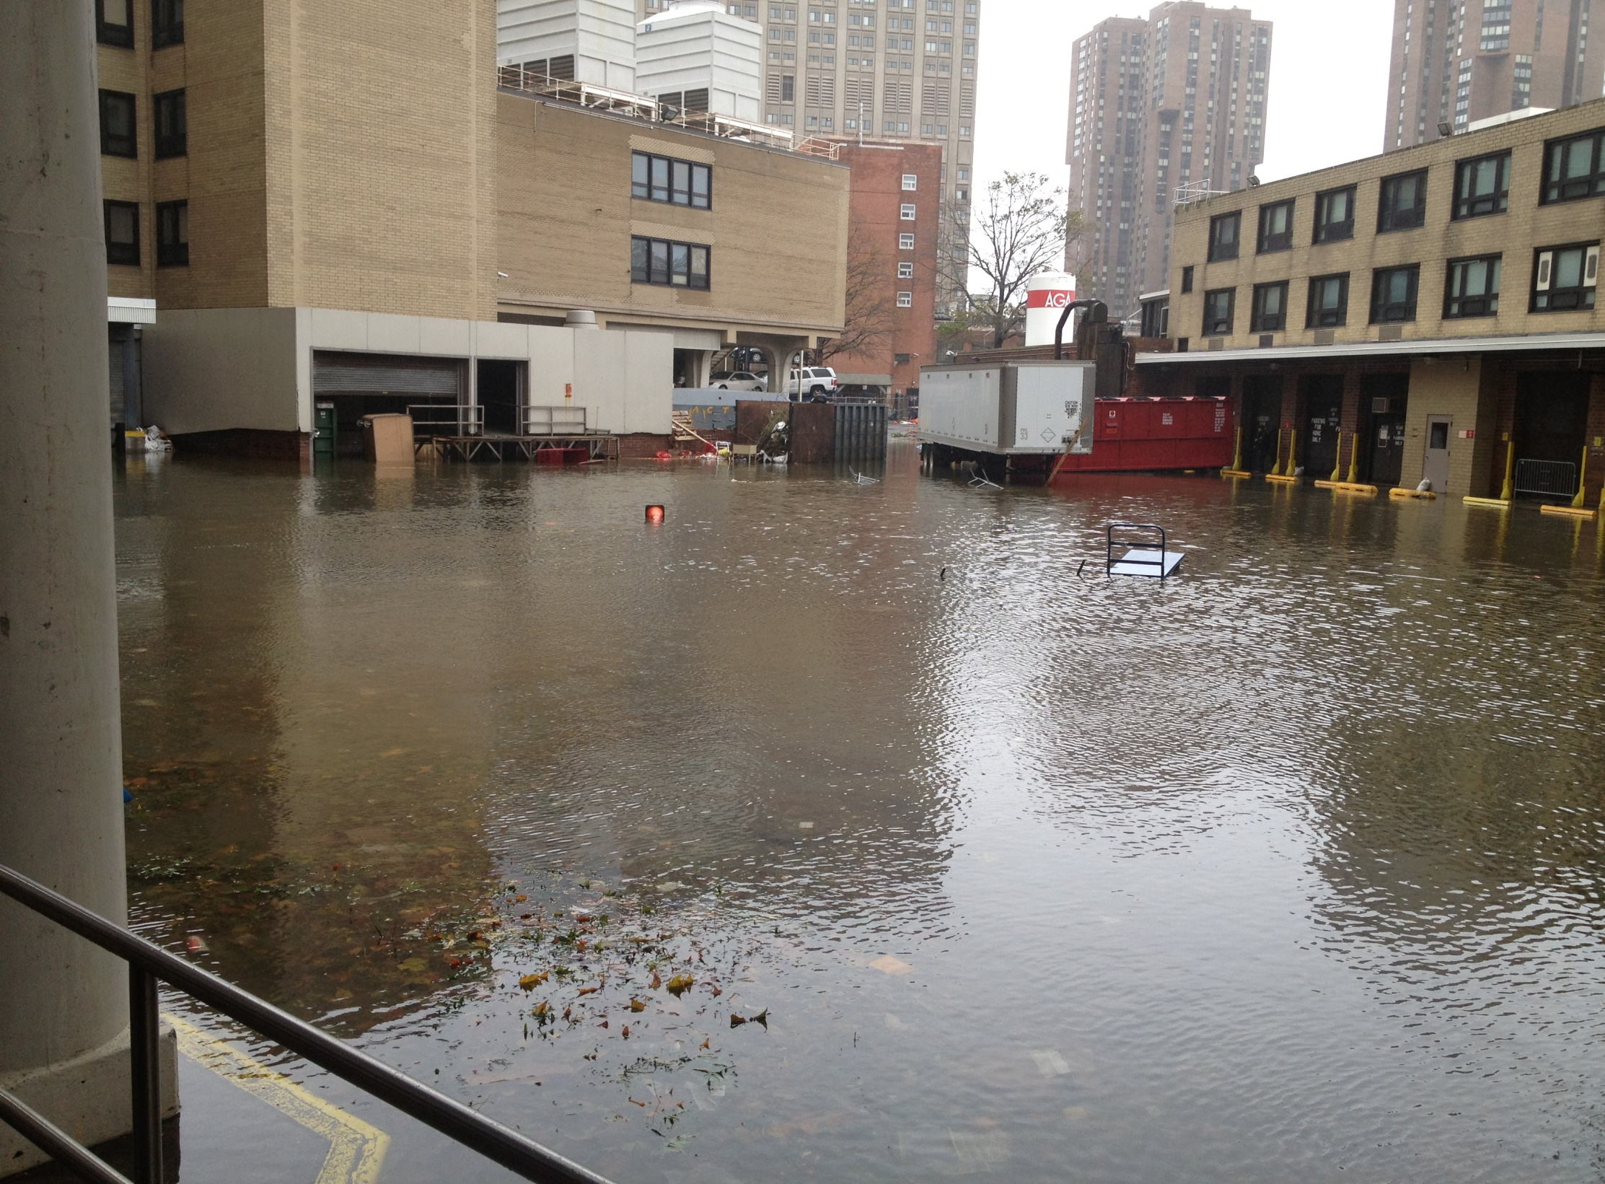

Slide 10
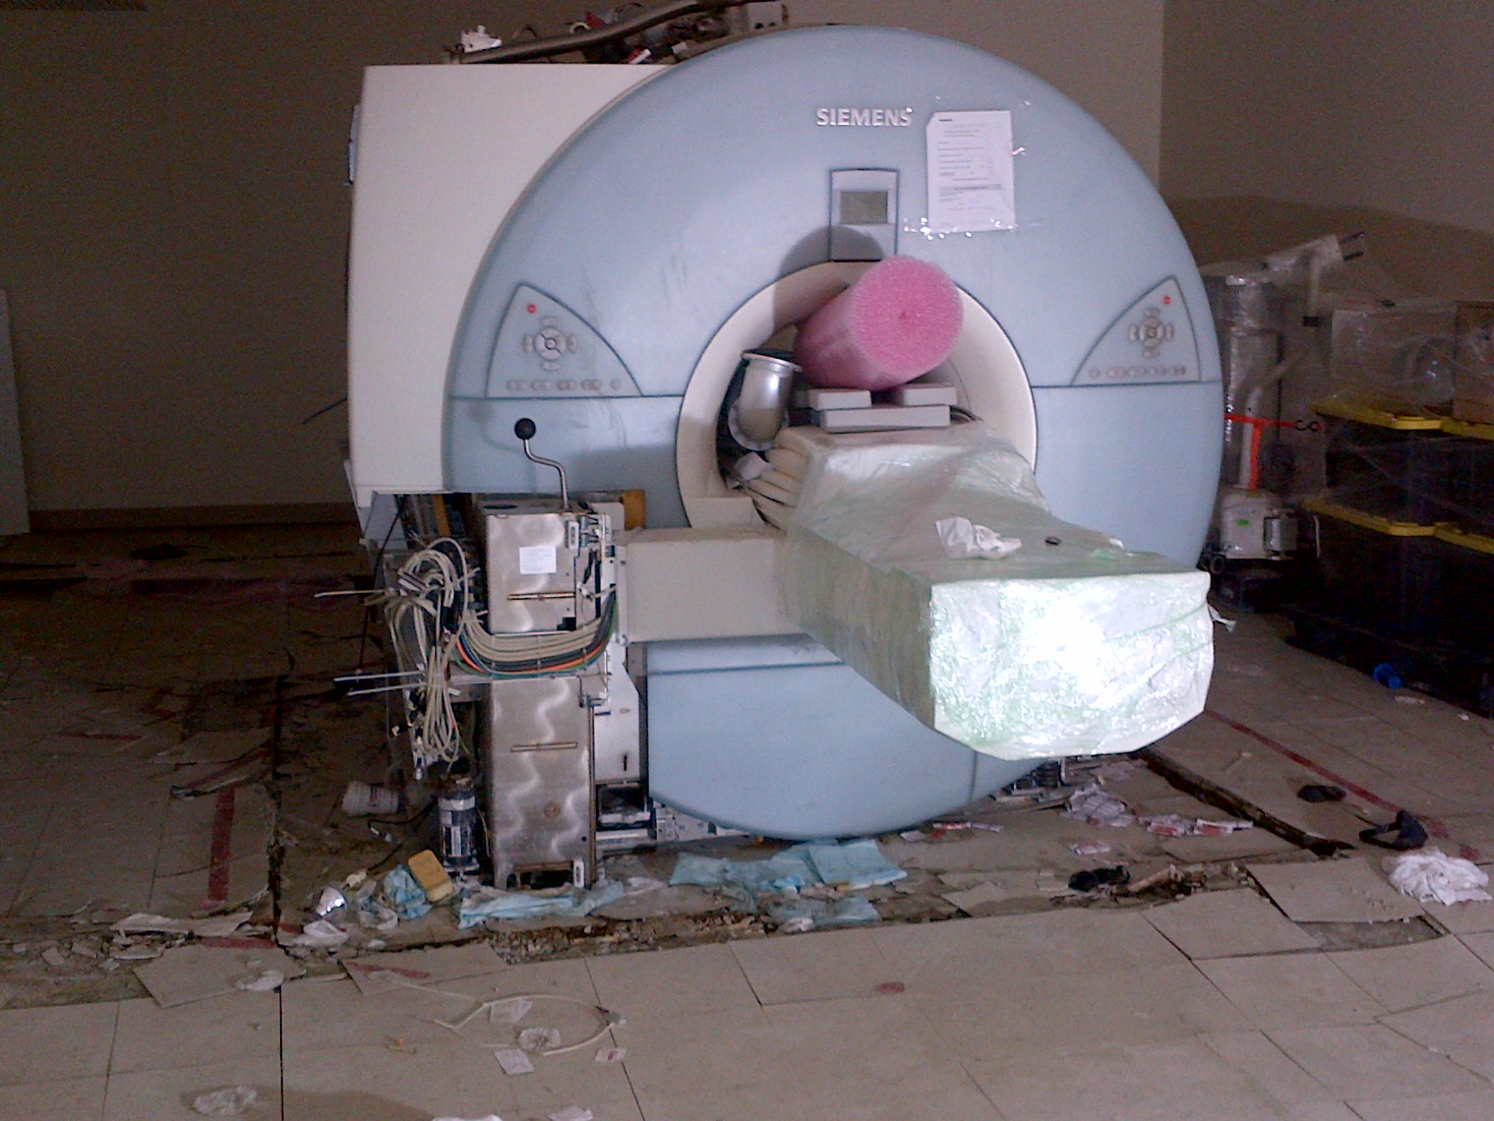

Slide 11
Monday October 29th 2012
Raw Sewage backed up into the flooded ground floor
Sterilizers were pushed across the room from the force from the water.
Toilet paper from the raw sewage was found at the base of the sterilizers.

Slide 12
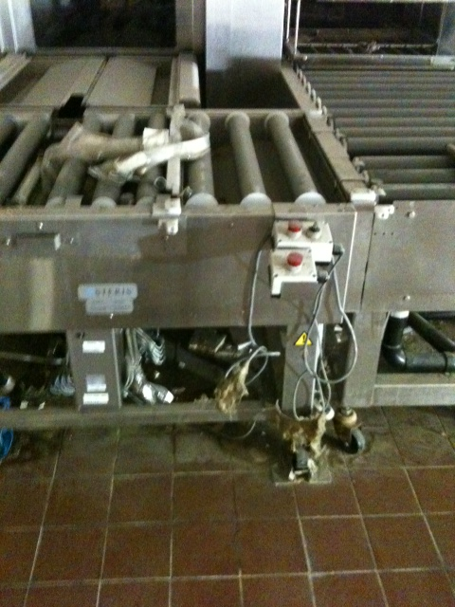

Slide 13
Infection Control Issues Post Sandy
Mold
  Mold was a major problem
  All walls and insulation was removed( took 3 mths)
  Pipes were sanitized with a bleach solution by a contracted company(Polygon)
  Machines in SPS were encased in mold over a very short period of time
  All SPS machines have been discarded

Slide 14
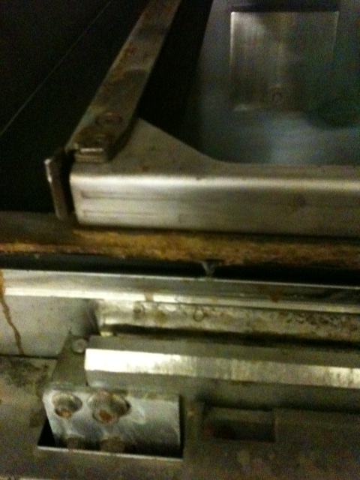

Slide 15
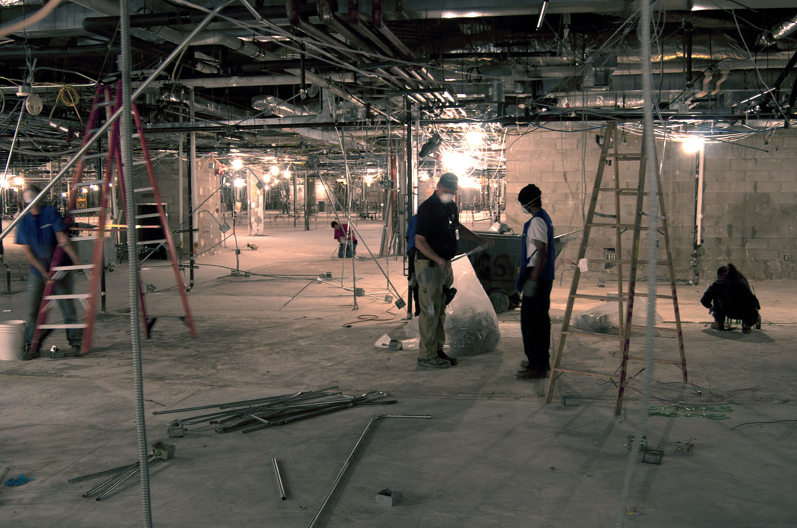

Slide 16
Contaminated Air
Stagnant contaminated air - causes contamination on upper levels of the building through evaporation.
Sterile instrument trays and supplies wrapped in absorbent materials on upper floors were now considered contaminated and needed to be removed.
Mold and contaminants found in duct work on upper floors of building, 2 weeks post Sandy.
The Industrial Hygienist with an outside contractor conducts air and water testing in all areas of the medical center to assure safety of the employees.

Slide 17
Temperature and Humidity
Temporary generators caused erratic swings in temperature in the building( high 90 -low 40)
Swings in temperature yield issues with supplies on units
  Blood culture broth
  IV fluids
  Medications in pharmacy and on units
  Reagents

Slide 18
Reconstruction
Numerous construction projects underway.
IC involved in all phases from beginning of planning to blueprint development.
IC is involved in ICRA development and contractor compliance.
Construction site rounds daily to check for compliance issues.
RTLS system for tracking instruments

Slide 19
March 1st 2013
Reopening of the NY Campus
The Clean up process is still on going.
All air ducts and filters changed and cleaned. Biological testing completed and all clear given.
Medical gases forthcoming in next few weeks
Opened Dermatology Clinic, Urgent Care, Walk in Clinic, Cysto, Dialysis, and PTSD clinics.
In next few weeks
  GI,ENT, EYE, Surgical Clinics, Mental Health, and Primary Care are scheduled to reopen 3/18-25
  Inpatients will return by July 2013 or sooner pending fire system certification for inpatients.

Slide 20
Hurricane Sandy
The Brooklyn VA Experience
Elizabeth Maccario RN BSN CIC

Slide 21
Sunday Oct. 28, 2012
Accepting patients from the NY Campus
Computerized medical record and bed board listed patient’s on precautions.
Not enough isolation rooms so more patients needed to be co-horted.
As day progressed more beds were needed
ER placed on diversion. Many pt’s were sent to East Orange and the Bronx VA’s.

Slide 22
Expansion of Patient Services at the Brooklyn Campus
Formally closed units were resurrected to accommodate increase in patient load.
Cardiac catheterization trailer rented and placed outside of building to accommodate stent procedures
Updated cardiac catheterization room to accommodate pacemaker insertions.
7 bed hemodialysis unit opened to accommodate NY campus patients.
Extra supply rooms with check point system.

Slide 23
Renovations of Existing Areas
Work with Engineering Service to ensure unit meets infection control guidelines
Walkthroughs daily to check progress and identify issues that may need to be completed prior to occupancy.
IC involved in all phases from beginning of planning to occupancy.

Slide 24
Changes in the OR
2 Operating Rooms were updated to accommodate Neurosurgery and Open Heart Surgeries.
Both services not performed previously in the Brooklyn Campus
Multiple modifications were needed to accommodate these services.

Slide 25
Other Services
Interventional Radiology
Urgent Care
Mental Health
Step Down (Neurosurgery and Open Heart)
Increase in Telemetry beds.
Increase in clinics including Primary Care and Specialty clinics.

Slide 26
Staffing Challenges
2 different medical schools with residency programs.
2x the nursing and clerical staff
Increased supply demands and decreased space.
Increase in equipment for patients.

Slide 27
SPS Challenges
Smaller space for decon and sterilization
Increased procedures and instruments yielded an increase in SPS workload.
In order to accommodate staffing and space issues in SPS, dental instruments were sent out for sterilization to an outside vendor. ( Dental service in the NYVA is the largest in the Nation with 20 chairs)

Slide 28
SharePoint for SOPs
All SOPs for RME are on a SharePoint site.
Accessible through VA computer system to all staff.
Standardized Harborwide.

Slide 29
Conclusions
No reportable outbreaks
No Cardiac Surgery or Neurosurgery infections.
Increase in flu vaccinations of staff and patients.
No increase noted in BBP exposures.
Staff worked well together under crowded conditions.
All looking forward to returning to NY and getting back to normal

