Slide 1
2010 New York State
Hospital Acquired Infection (HAI)
Public Report and National Trends
HAI Public Reporting Update
APIC-GNY–November 9, 2011
Carole Van Antwerpen, Assistant Bureau Director
New York State Bureau of Healthcare Associated Infections Hospital Acquired Infection Reporting Program

Slide 2
Program Objectives
State the NYS mandate for public reporting or HAIs
Identify scope of other States’ public reporting mandates
Describe National HAI public reports.
Identify impact of public reporting of HAIs in NYS
Impact of HAI prevention collaboratives

Slide 3
Key Elements of 2005 NYS Legislation (PHL 2819)
  Consultation with Technical Advisors
  Hospitals to report surgical site infections (SSIs) and
  central line associated bloodstream infections (CLABSIs)
  Select and provide training to hospitals on reporting system
  Audit (internal/external) to validate accurate reporting
  Meaningful and risk adjusted comparisons-public report
  Annual Public HAI report on or before September 1(2010).

Slide 4

State Reporting of HAIs

Slide 5
Scope of HAI Public Reports by States
28 States with mandates for HAI public reporting
12 States with public reports released (2006-2010)
  First report
  2006: Missouri, Pennsylvania
  2008: Vermont
  2008: NYS, South Carolina
  2010: Tennessee
  2010: Illinois, Oregon, New Hampshire, California*, Colorado, Washington,
Data Validation (excluding NYS)
  Internal “point of entry” – 3 states
  On-site audit – 5 states (2010) but only for CLABSI

Slide 6
Hospital rates reported by states - continued
Ventilator associated pneumonia-ICU/LTAC-(1) state
MRSA or VRE bacteremia facility-wide – (1) state
MRSA facility-wide- aggregate rate only – (2) states
  Use ICD-9 discharge codes
C. difficile facility – (3) states
  Use ICD-9 discharge code-aggregate rate – (1) state
  Paper/fax/ NHSN LabID facility wide- (1) state
    April 2010 changed to NHSN LabID event
  NHSN LabID facility-wide – (1) NYS (data validation)

Slide 7
First Public Report: State (# Hospitals) | Procedures | Other | Data Validation
2008:New York (177) | HPRO, CABG, Colon | C.dfficile Lab ID event | Internal-yes, 2007:on-site-yes
2008: South Carolina (62) | HPRO, KPRO, CABG, Colon*, Abd. HYST | MRSA Lab ID bacteremia (aggregate rate only). | Internal-yes, 2009:on-site-yes
2011: Vermont (13) | HPRO, KPRO, Abd. HYST | none | none
2006: Missouri (69) | Inpatient: HPRO, CABG, Abd. HYST; (ASC:Breast, Hernia) [not NHSN] | none | none
2009:Pennsylvania (266) | HPRO, KPRO, CABG, Abd. HYST, CARD | All infections, CAUTI-hosp-wide | some for CLABSI and SSI
2011: Tennessee (76) | none | ICU-CLABSI, CABG-aggregate rates | Internal-yes, on-site-yes, CLABSI only
2010:Oregon(48) | HPRO, KPRO, CABG, Colon, Abd. HYST, LAMI | CLABSI-ICU overall | on-site-yes 2010:CLABSI
2009:Colorado (59) | HPRO,KPRO,CABG,Abd/Vag HYST, Hernia | Dialysis treatment 2010), ASC (2008) | 2010:on-site- yes
2010:New Hampshire (26) | KPRO, CABG, Colon | CLIP, HCW Flu vac.rates | Internal-yes, 2011:on-site

Slide 8
First Public Report: State (# Hospitals) | Procedures | Other Indicators | Data validation
2011:Illinois (86) | none | ICU CLABSI C.diff and MRSA aggregate rates using ICD9 disch. codes | none
2010:Washington (62) | none | VAP and CLABSI all ICU and LTAC | internal-yes, 2011:on-site-random
2010:California (383) | None (2012- 29 procedures) | MRSA and VRE Bacteremia, C.diff.-facility- wide; ICU CLABSI | No internal, 2011:on-site voluntary

Slide 9

National Reporting of HAI Rates

Slide 10
National Reporting of HAIs* (4000 Hospitals)
Centers for Medicaid and Medicare Services (CMS) vs. NY State
HAI Event | Facility Type | Start date for Reporting | NYS Mandated Reporting
CLABSI | Acute Care Hospitals Adult, Peds, Neonatal ICUs | January 2011 | Yes
CAUTI | Acute Care Hospitals Adult and Peds. ICU | January 2012 | No, TBD later in 2012
SSI | Acute Care Hospitals Colon and Abd Hyst. | January 2012 | Yes, plus CABG and HPRO
MRSA Bacteremia | Acute Care Hospitals Facility-wide | January 2013 | TBD later in 2012
C. Difficile LabID event | Acute Care Hospitals Facility-wide, Inpt.Rehab | January 2013 | Yes, acute care, Inpt. Rehab (NHSN discuss)
Healthcare worker Flu vaccination | Acute Care Hospitals | January 2013 | ? Not part of HAI
* CMS reporting via National Healthcare Safety Network (NHSN)

Slide 11
How and When Will CMS Report
Hospital ICU CLABSI Rates in 2011?
Reporting Standard Infection Ratio (SIR)
Reported as SIR for all adult/pediatric ICUs combined
Reported as SIR for NICU all birth weights combined
Individual Hospital SIRs calculated by NHSN and transmitted to CMS for posting on “hospital compare”
First quarter SIR sometime in November 2011?
SIR Updated quarterly thereafter
Data Validation:
Hospitals to “self-validate” data entry errors (NHSN tools)
CMS Audit CLABSI events-TBD at a later date

Slide 12
How Will CMS Report SSIs?
ALL colon and abd. hyst. Procedures and ALL SSIs reported to NHSN
Reporting Standard Infection Ratio (SIR)
Reported combined SIR for colon and abd. hyst.
Only deep and organ space SSIs in SIR calculations
Individual Hospital SIRs calculated by NHSN and transmitted to CMS for posting on “hospital compare”
First quarter SIR sometime in November 2012?
SIR Updated quarterly thereafter
Data Validation:
Hospitals to “self-validate” data entry errors (NHSN tools)
CMS Audit SSI events-TBD at a later date

Slide 13

Remember: Compare Apples to Apples

Slide 14
Centers for Disease Control (CDC)
NHSN State-Specific Report Cards
First State Report Card- January –June 2009
  Includes ALL CLABSIs from non-neonatal patient care locations
  CLABSI reported as a SIR
    SIR actual CLABSI divided statistically expected CLABSI
    SIR for the 17 States with a mandate and using NHSN
  Interpreting the SIR
    SIR: >1 means higher than National SIR
    SIR < 1 means lower than national SIR
  2009 National CLABSI SIR = 0.85
  States with SIR >1.0 also with audit validation process
  Impact of CMS CLABSI Reporting on National Rate?

Slide 15
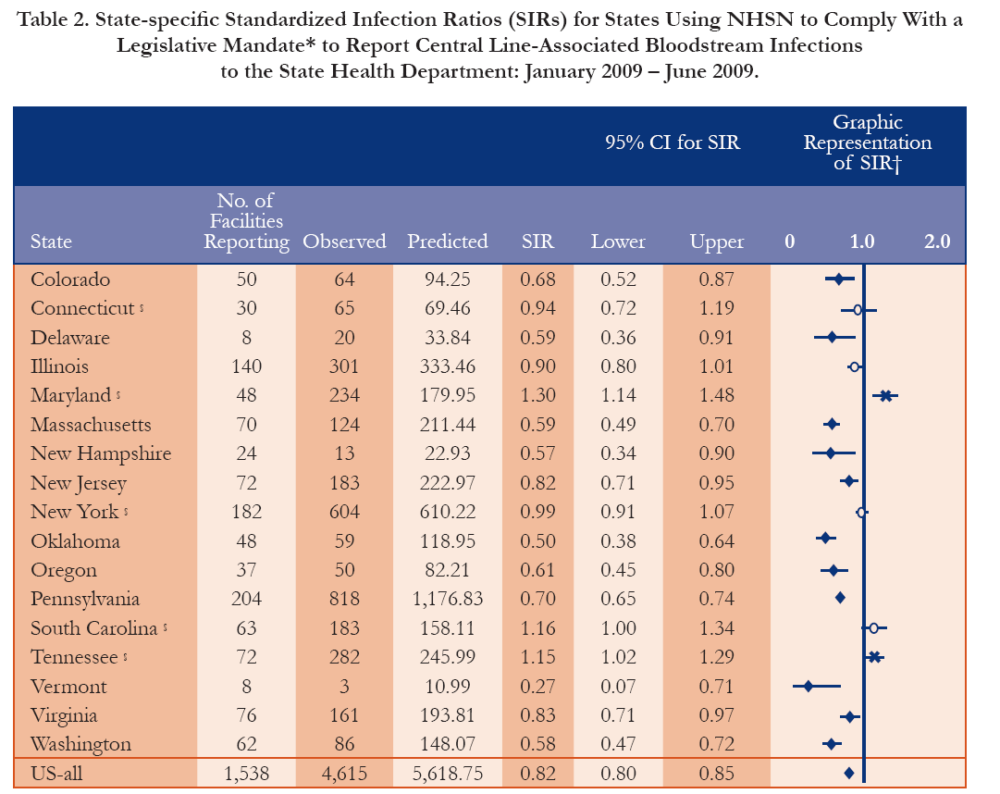

Slide 16
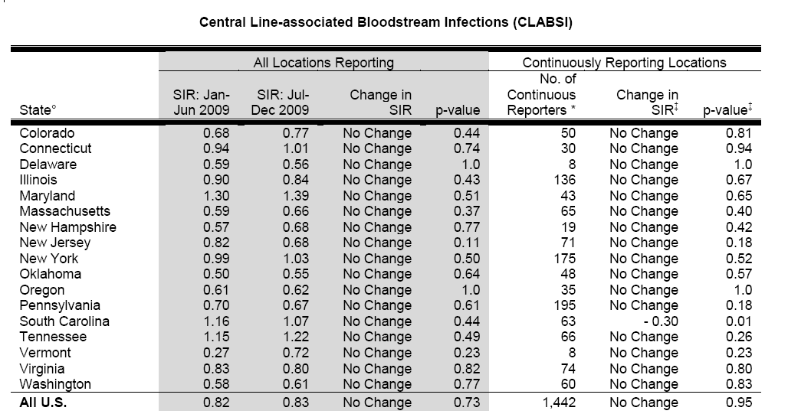
http://www.cdc.gov/HAI/pdfs/stateplans/state-specific-hai-sir-july-dec2009r.pdf
CDC published MMWR March 2011

Slide 17
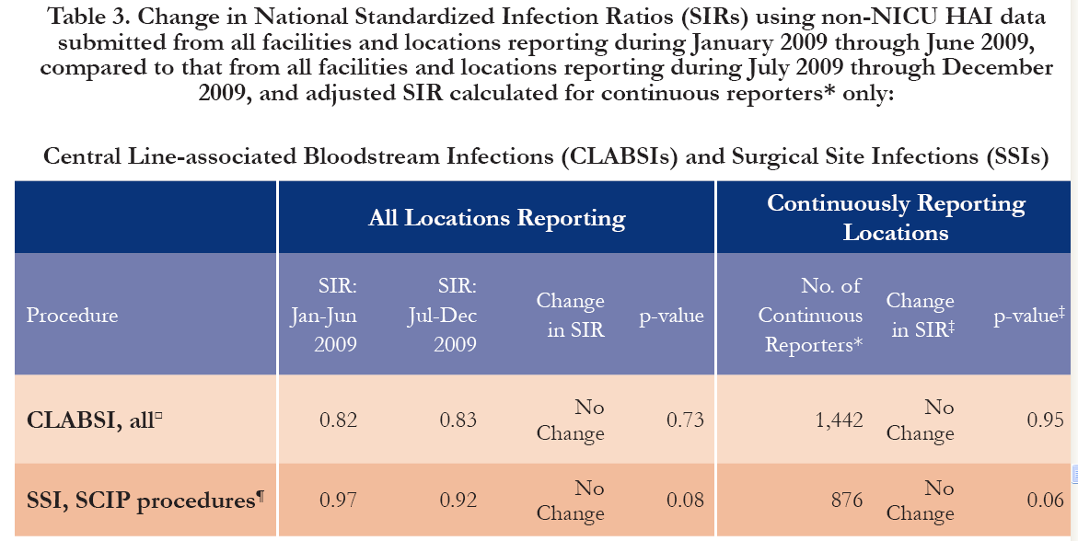
Centers for Disease Control and Prevention
Only deep incision and OS SSIs identified on admission and readmission included in SIR calculations (note: NHSN rates include superficial and PDS)
SCIP procedures are: vascular, CABG, Cardiac, colon, HPRO, KPRO, Abd.and Vag. Hysterectomy
Reference Period: Facilities reporting between 2006-2008 (baseline)

Slide 18
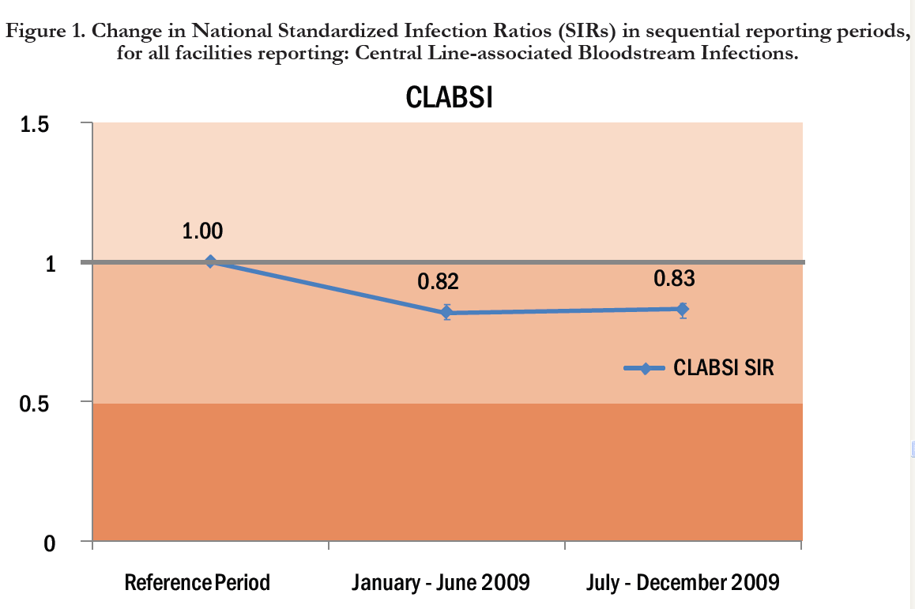
National Healthcare-Associated Infections Standardized Infection Ratio Report: July 2009-December 2009, Released by CDC March 2011

Slide 19
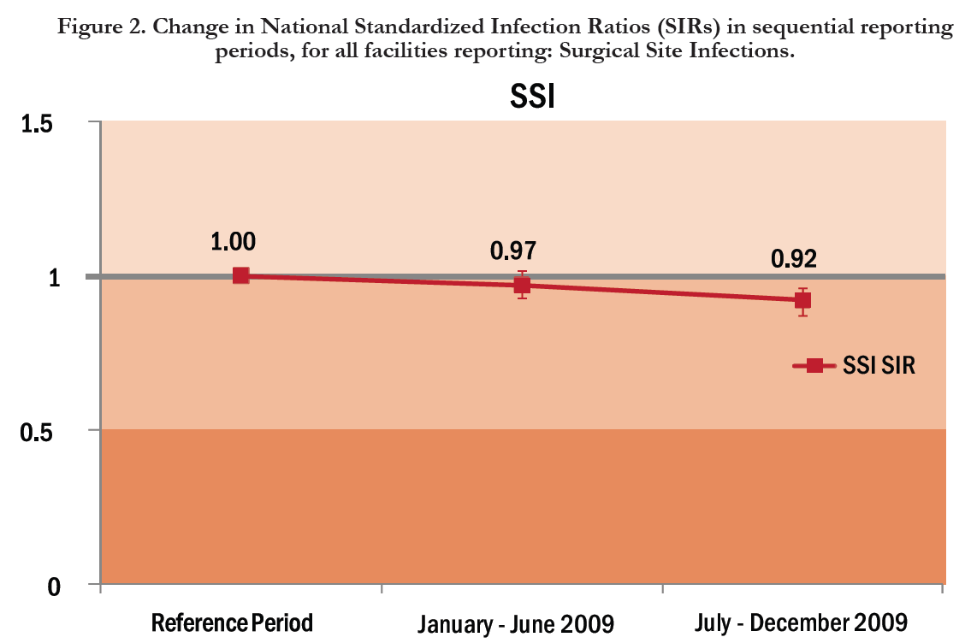
National Healthcare-Associated Infections Standardized Infection Ration Report: July 2009-December 2009,
Released by CDC March 2011

Slide 20
Health and Human Services: 2010-2015
5 year national HAI prevention targets (reductions)
Included in 2010 State HAI Plans – all 50 states
Template of HAI Prevention Targets to monitor
  CLABSI –NHSN facility–wide or location specific
  CLIP adherence percentage- NHSN
  SSIs – CMS SCIP and/or other procedures
  CMS SCIP measures adherence
  C. difficile – discharges, NHSN LabID
  CAUTI- NHSN facility–wide or location specific
  MRSA incidence rates (CDC EIP/ABC)
  MRSA Bacteremia- NHSN MDRO

Slide 21
HHS-NYS HAI Prevention Targets
HAI Indicator | % Reduction from Baseline
CLABSI- adult, pediatric, neonatal ICUs | 50%
C. difficile facility wide | 30%
SSI- HPRO, colon CABG, | 25%
SCIP adherence (NYSDOH Patient Safety Center) | TBD

Slide 22
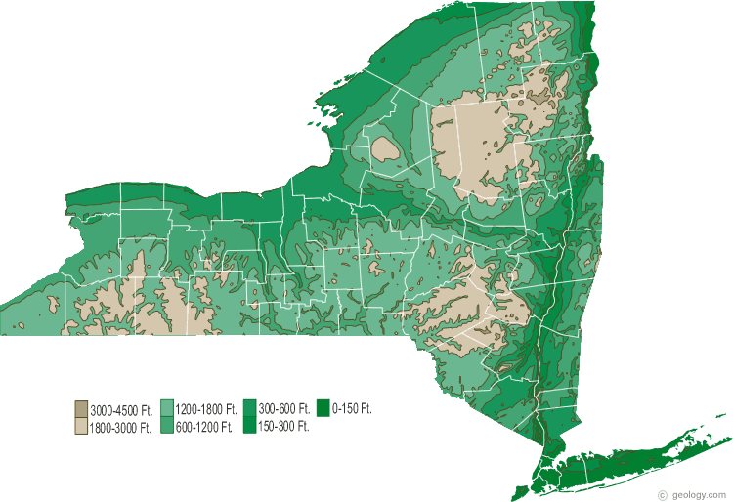
So How is NYS Doing?

Slide 23
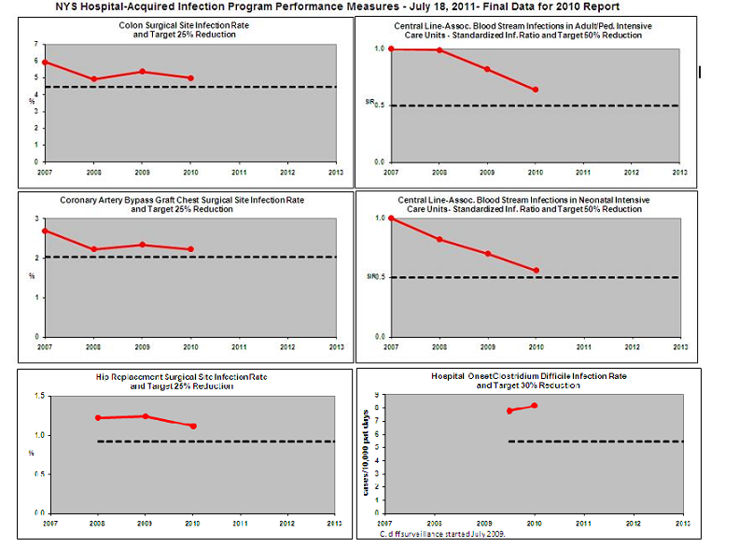

Slide 24
NYS Audit/Validation Process is Key to “Realized” Reductions in HAIs
Ensure accurate/fair reporting and more reliable HAI rate comparisons by identifying:
Internal and external validation efforts
    Timeliness of data submission
    Accuracy of data reported
    Users understanding of NHSN protocols
    Provide feedback to hospitals
    Hospital surveillance “system” issues
    NHSN protocol inconsistencies

Slide 25
2009/2010 - Sample of Charts Selected for Review for Each Surgical Procedure Type
Number of NHSN Procedures | Total Number Charts For Review | Number of Cases | Number of Controls | Percent of NHSN Data Reviewed
9 to 79 | 9 | 3 | 6 | 9% to 100%
80 to 299 | 12 | 4 | 8 | 4% to 15%
300 to 999 | 15 | 5 | 10 | 2% to 5%
1000 + | 18 | 6 | 12 | 0.6% to 2%
Note: Additional records can be requested by the HAI regional staff for review

Slide 26
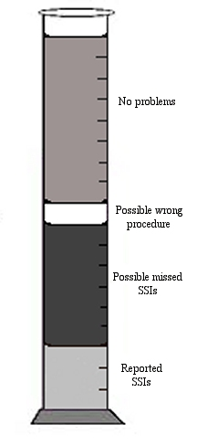
Order of Surgical Record Selection
4
Reported SSI
Possible missed SSI from SPARCS or CSRS
Possible wrong procedure
No Problem
3
2
1

Slide 27
Denominator Audit Findings
HPRO

Slide 28
Denominator Audit Findings
CABG Procedure

Slide 29
Denominator Audit Findings
COLON Procedure

Slide 30
Audit Results in Identifying
Missed SSIs Reported
Audit Year | CABG (n=missed SSI/ records audited) | Colon (n=missed SSI/ records audited) | Hip Replacement (n=missed SSI/ records audited)
2007 † | 0.9% (2/213) | 3.0% (19/642) | NA
2008 ∗ | 0.6% (3/462) | 0.7%(12/1762) | 0.5% (8/1544)
2009 ‡ | 2.5% (14/558) | 6.1% (93/1519) | 0.4% (7/1572)
2010 ‡ | 5.4% (20/368) | 7.3% (83/1140) | 1.1% (15/1321)
Excludes records not primarily closed/not NHSN procedures
† Case control study- internal/external controls
* Cases/controls from NHSN same hospital
‡ Change in record selection
Missed by surveillance 83%
Misinterpretation of SSI criteria 12%
Data entry/reporting error 3%
Diagnosis readmit another hospital 3%

Slide 31
External Data Review
Central Line Audit- Intensive Care Unit
Compliance with NHSN protocols
Evaluate under/over reporting of CLABSI
  Reviewer - Line list of NHSN CLABSI
  IP- Laboratory list of positive ICU blood cultures
  Patient records for the most recent ICU positive bloods
    Sample of records per ICU (adult[20],pediatric [10], neonatal [20])
    Additional records if low reporting or % of ICU beds
Assess internal denominator collection process (CL days)

Slide 32
External Data Review
Adult/Pediatric ICU Medical Record Audit
Over and Missed Reporting of CLABSI
Percent Differences
 | 2007 (N= 147 /184 hospitals) | 2008 (N=130/184 hospitals) | 2009 (N=157/178 hospitals) | 2010 (N=127/172 hospitals)
CLABSI | % disagree (n=615) | % disagree (n=459) | % disagree (n=827) | % disagree (n=1106)
Over Reporting (total = 74) | 7.2% (44) | 1.5% (7) | 1.2% (10) | 1.1% (13)
Missed CLABSI Reporting (total = 187) | 7.0% (43) | 8.9% (41) | 5.6% (46) | 4.8% (57)
Percent agreement | 86% | 90% | 93% | 91%
n = number of patients with a positive blood culture and Central line while in ICU
Infection at another site meets NHSN Surveillance criteria
(AJIC-June 2008)

Slide 33
CLABSI Audit Findings
NICU
Notes:
Underreporting is in decreasing trend but still significant

Slide 34

Overview of the 2010 NYS HAI Public Report- Released September 20, 2011

Slide 35
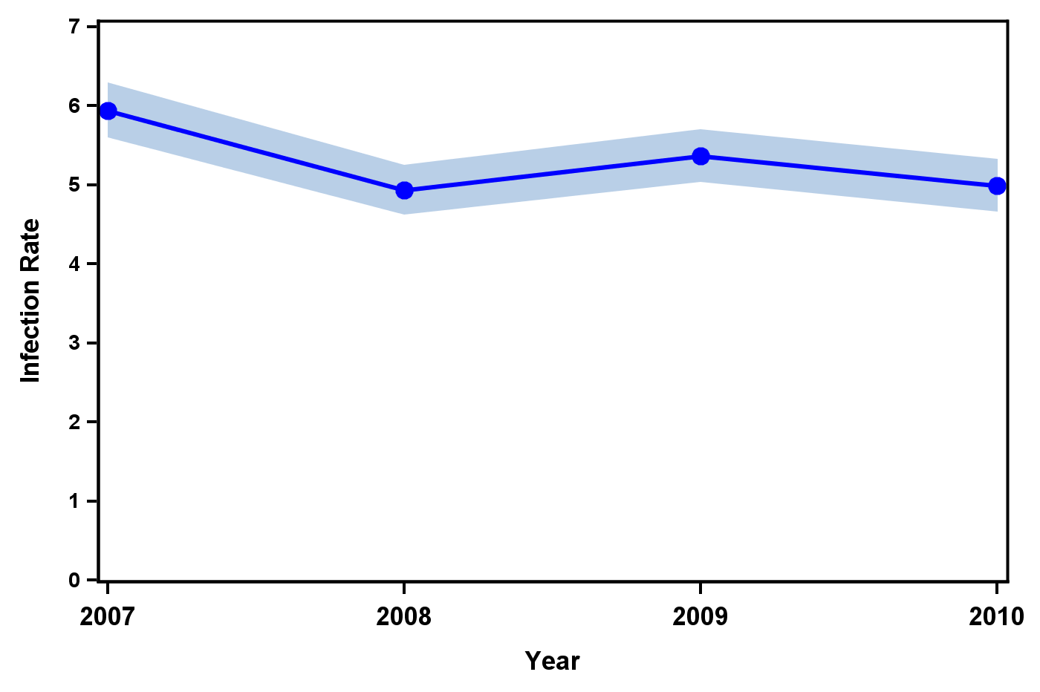
Trend in Colon Surgical Site Infection Rates, New York State 2007-2010

Slide 36
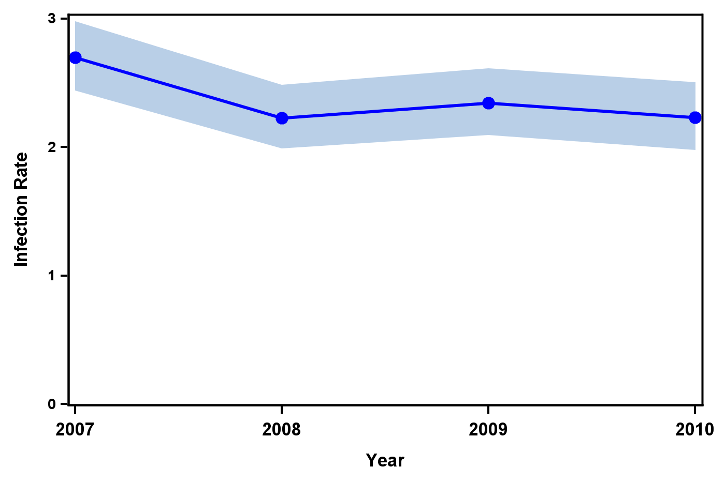
Trend in Coronary Artery Bypass Graft Chest Site Infection Rates, New York State 2007-2010

Slide 37
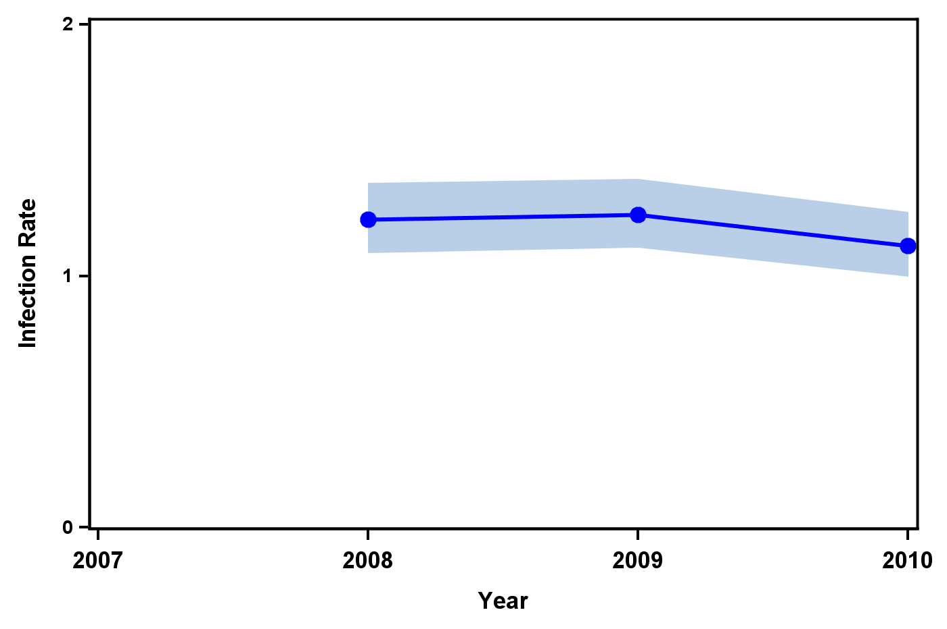
Trend in Hip Surgical Site Infection Rates, New York State 2008-2010

Slide 38
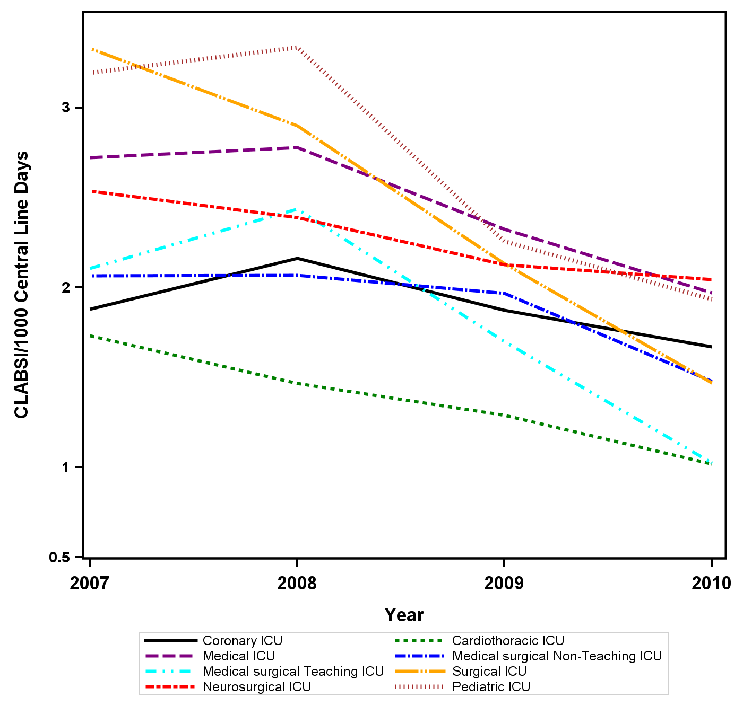
Trend in CLABIS Rates in Adult and Pediatric Intensive Care Units, New York State 2007-2010

Slide 39
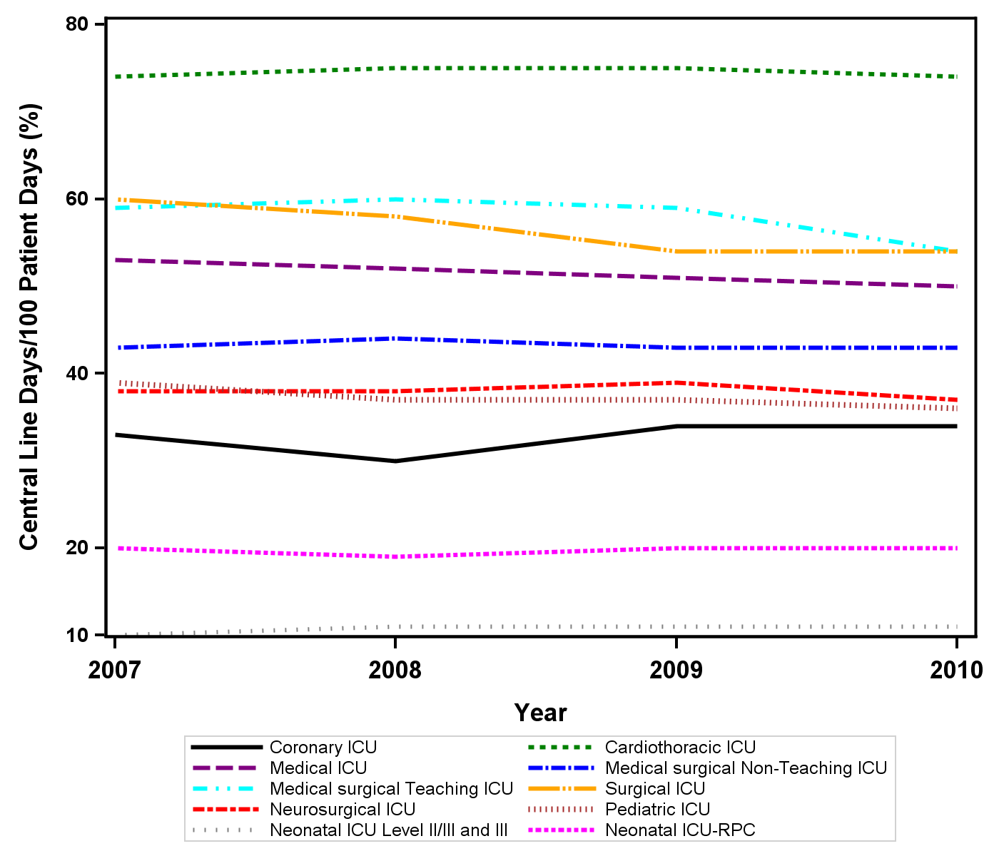
Device Utilization Remains Unchanged

Slide 40
Summary of Trend in all NYS CLABSI and SSI Data
Year | Actual Infections | % CLABSI reduction since 2007
2007 | 1439 | NYS baseline
2008 | 1557 | 5%
2009 | 1310 | 20%
2010 | 1007 | 37%
Year | Actual Infections | % SSI reduction since 2007
2007 | 1600 | NYS Baseline
2008 | 1640 | 14%
2009 | 1699 | 8%
2010 | 1512 | 15%

Slide 41
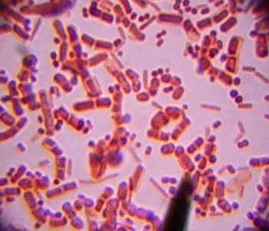
Clostridium difficile
Facts about reporting C. difficile rates.
C. difficile categories
Definitions
Rate Calculations

Slide 42
Considerations in Public Reporting of
C. Difficile
First State to report C. difficile rates using a systematic method including validation of hospital data
Significant limitations in risk adjustment of data
Anticipated misunderstanding by the public about the role hospitals play in C. difficile acquisition
Discharge ICD-9 coding may result in inflated HAI rates (AHRQ)
Inconclusive; more sensitive C. diff. testing methods inflate HO, CO, or CO-PMY rates
Many more lessons still to be learned about HAI rates

Slide 43
NYS Reporting of Clostridium difficile Rates
Community Onset-Not-My-Hospital (CO-NMH): Documented infection occurring within 3 days of hospital admission or more than 4 weeks after discharge from the same hospital. Not associated with being acquired while hospitalized.
Community Onset-Possibly-My-Hospital (CO-PMH): Documented new infection within three days of readmission to the same hospital when a discharge from the same hospital occurred within the last 4-weeks.

Slide 44
C. difficile
Hospital-Onset(HO): cases in which the positive stool sample was obtained on day four or later during the hospital stay.
Hospital-Associated (HA): includes HO and CO-PMH.
    Rate = number of HO cases and the number of CO-PMH cases, divided by the number of hospital inpatient days and multiplied by 1000.

Slide 45
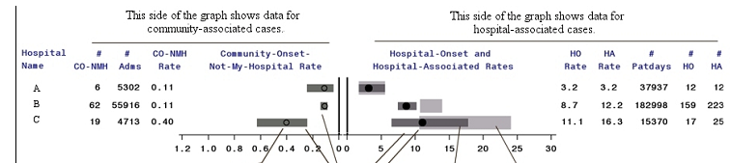
State HO = 8.2
Hospital A: low CO-NMH rate and a low HO rate. HO rate is equal to the HA rate.
Hospital B: higher HA rate than HO rate, more cases of C. difficile within 4 weeks of the last discharge to this specific hospital (CO-PMH).
Hospital C: high HO rate and high CO-NMH rate. Rates higher (? ) a more sensitive test or test more frequently, or high risk population such as elderly from nursing homes.

Slide 46
Reporting of Hysterectomy Procedures and SSIs……..What to anticipate?
Iroquois HAI Public Reporting Project
Surgical Site Surveillance Abdominal and Vaginal Hysterectomy- 10/01/1999-09/30/2000
How SSIs were Identified
Detected | Number of SSIs | Percent
Admission | 12 | 17.9%
Post-Discharge | 32 | 47.8%
Readmission | 23 | 34.3%

Slide 47
Reporting of Hysterectomy Procedures and SSIs……..What to anticipate?
Iroquois HAI Public Reporting Project
Abdominal Hysterectomy SSIs –
10/01/1999 - 09/30/2000
Culture Results/Infection Site | Number | Percent
Culture positive | 27 | 49.1%
Culture negative | 5 | 9.1%
No culture | 23 | 41.8%
Skin (superficial) | 36 | 65.5%
Soft Tissue (deep) | 4 | 7.3%
Organ Space | 15 | 27.3%

Slide 48
NYS DOH HAI Reporting Program Collaborative Prevention Projects
ICU VAP implementing IHI strategies – HANYS
Hospital-wide Clostridium difficile – GNYHA
Regional Perinatal Centers (CLABSIs in NICUs)
MRSA infection versus transmission – Continuum
Reducing PICC HAIs- Continuum
MRSA infection vs. transmission, CHG Baths – North Shore
Chlorhexidine bathing on BSIs/MDRO in ICU patients – Westchester County Healthcare Association
Prevention of CLABSI in non-ICU inpatients- Rochester
Antimicrobial Stewardship pilot project in hospitals and affiliated nursing homes –GNYHA/UHF (new 2009)

Slide 49
Conclusions on Public Reporting of HAIs
Efforts needed to align NYS HAI indicators with National
NYS SIR rates may be higher when compared to National
  Systematic and consistent audit/validation process
  Differences in data included/excluded/denominators
  Underreporting to maximize CMS prospective payment
  Differences in numerator case finding methods
NYS CLABSI ICU rates are decreasing
NYS SSIs rates are decreasing, (colon and CABG)
NYS C. difficile rate is 8.2, efforts needed to reduce
Collaboratives important to reducing HAIs
January 1, 2012, Inpatient abdominal hysterectomy’s to be reported (NHSN-Patient Safety Protocol (pg.9.4)

Slide 50

Whew……….that was a lot of information
But - Most of All

Slide 51



FINAL FACTS
Understand what is behind the rates included reports
Educate your customers about published rates
Utilize your resources
AND

Slide 52
Team Effort
Regional
Central Office
Carole Van Antwerpen-Immediate Capital
Kate Gase- NYC, New Rochelle
Marie Tsivitis- Long Island
Diana Doughty- Central, Capital, New Rochelle
Peggy Hazamy – Western
Participating Hospitals
Carole Van Antwerpen
Valerie Haley
Boldt Tserenpuntag
Harry Xiong
Cindi Dubner
Trish Lewis
Kijiafa Burr

Slide 53

Questions
clv02@health.state.ny.us
York State Public HAI Report- 2007/08/09/10 hospital rates identified HAI Report: http://www.health.ny.gov/statistics/facilities/hospital/hospital_acquired_infections/New

