Slide 1
PENN CENTER FOR EVIDENCE-BASED PRACTICE
Estimating the proportion of reasonably preventable hospital-acquired infections and associated mortality and costs
Craig A Umscheid, MD, MSCE, FACP
Assistant Professor of Medicine and Epidemiology
Director, Center for Evidence-based Practice
University of Pennsylvania
APIC Greater NY - 15th Symposium
November 9th, 2011

Slide 2
Outline
Review methods and findings of our recent study on the preventability, impact and cost of HAIs
Review guideline recommendations on preventing CAUTIs
Review guideline recommendations on preventing CABSIs
Provide status report on CDC efforts to update the 1999 guideline on preventing SSIs
Conclusion and Discussion

Slide 3
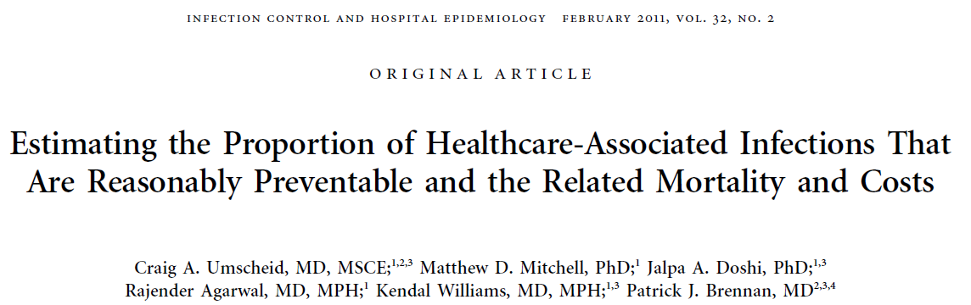

Slide 4
Study Background
Hospital acquired infections (HAIs) are common, and numerous strategies to prevent them have been studied
In Oct 2008, Medicare began to encourage hospitals to adopt these strategies by instituting a policy of nonpayment for “reasonably preventable” HAIs, including CABSI, CAUTI and SSI

Slide 5
National Standards
CMS Partnership for Patients
  Nine core areas of focus, four areas are HAIs:
    CAUTI
    CABSI
    SSI
    VAP
Joint Commission’s 2011 National Patient Safety Goals
  NPSG.07.04.01
    Use proven guidelines to prevent infection of the blood from central lines
  NPSG.07.05.01
    Use proven guidelines to prevent infections after surgery
  NPSG.07.06.01
    Use proven guidelines to prevent indwelling catheter-associated urinary tract infections

Slide 6
Study Objectives
Some have asserted that not all HAIs are preventable, and that new incentives and mandates punish hospitals that care for patients at high risk of HAIs
To inform discussions regarding the preventability of HAIs, we estimated:
    the proportion of HAIs in US hospitals that are reasonably preventable
    mortality and costs associated with reasonably preventable HAIs

Slide 7
Methods
Range of proportion of HAIs that are preventable (%) ¹
X
Annual number of HAIs and HAI deaths ²
=
Range of annual number of preventable HAIs and HAI deaths
Range of annual number of preventable HAIs
X
Incremental cost of HAIs ³
=
Range of annual avoidable HAI costs

Slide 8
Study Methods
Range of preventability
  Use an AHRQ systematic review that examined published interventions to reduce BSI, UTI, SSI, and VAP
  We constructed ranges of preventability for each HAI by using the lowest and highest risk reductions reported in the AHRQ review for higher quality US studies published in last decade
Annual number of HAIs and HAI deaths
  Use most recently published national data
Incremental cost of an HAI
  Perform a systematic review of the published literature
  Use data from US studies reporting comprehensive cost analyses adjusted for confounders

Slide 9
Study Results: AHRQ Systematic Review
Infection type | BSI | VAP | UTI | SSI
Total studies included in AHRQ report | 19 | 12 | 10 | 28
Excluded on quality grounds | 10 | 5 | 1 | 15
Excluded: more than 10 years old | 0 | 1 | 3 | 3
Excluded: didn’t report risk reductions for infections | 0 | 1 | 2 | 2
Excluded: non-US | 2 | 2 | 2 | 5
Included in this analysis | 7 | 3 | 2 | 3
15 studies included in our analysis
Ranji SR, Shetty K, Posley KA, Lewis R, Sundaram V, Galvin CM, et al. Volume 6--prevention of healthcare-associated infections. Rockville, MD: Agency for Healthcare Research and Quality; 2007 January 2007. Report No.: AHRQ Publication No. 04(07)-0051-6.

Slide 10
VAP Prevention Studies
Author Year | Study Design | Setting |  | Intervention | Comp | Risk before | Risk after | Risk Red.
Good quality
Babcock 2004 | Before- after study |  | ICU | Hand hygiene HOB>30° Daily interruption of sedation Clinician education | Previous care | 8.75 per 1,000 vent days | 4.74 per 1,000 vent days | 46%
Zack 2002 | Before- after study |  | ICU | HOB>30° Clinician education | Previous care | 12.6 per 1,000 vent days | 5.7 per 1,000 vent days | 55%
Moderate quality
Lai 2003 | Before- after study |  | ICU | HOB>30° Clinician education Audit & feedback | Previous care | SICU: 45.1 per 1,000 vent days | SICU: 27.9 per 1,000 vent days | 38%
 |  |  |  |  |  | MICU: 22.4 per 1,000 vent days | MICU: 11.6 per 1,000 vent days | 48%
Range of Risk Reductions = 38-55%

Slide 11
Range of Risk Reductions for all HAIs
HAI | Reduction in HAI risk with QI
BSI | 18%–66%
VAP | 38%–55%
UTI | 17%–69%
SSI | 26%–54%

Slide 12
Hospital-acquired infections in 2002
Type of HAI | Number of HAIs | Deaths from HAIs
BSI | 248,678 | 30,665
VAP | 250,205 | 35,967
UTI | 561,667 | 13,088
SSI | 290,485 | 8,205
Klevens RM, Edwards JR, Richards CL,Jr, Horan TC, Gaynes RP, Pollock DA, et al. Estimating health care-associated infections and deaths in U.S. hospitals, 2002. Public Health Rep. 2007;122(2):160-6.

Slide 13
Estimating Preventable HAIs and HAI Deaths
HAI | HAIs (N) | HAI Deaths (N) | Reduction in HAI risk with QI | Preventable HAIs (N) | Preventable HAI deaths (N)
VAP | 250,205 | 35,967 | 38%–55% | 95,078–137,613 | 13,667–19,782

Slide 14
Summary estimates of preventable HAIs and HAI deaths for all HAIs
HAI | HAIs (N) | Deaths (N) | Reduction in infection risk with QI | Preventable infections (N) | Preventable deaths (N)
BSI | 248,678 | 30,665 | 18%–66% | 44,762–164,127 | 5,520-20,239
VAP | 250,205 | 35,967 | 38%–55% | 95,078–137,613 | 13,667–19,782
UTI | 561,667 | 13,088 | 17%–69% | 95,483–387,550 | 2,225–9,031
SSI | 290,485 | 8,205 | 26%–54% | 75,526–156,862 | 2,133–4,431

Slide 15
Example Search: VAP Cost Studies
Search | Syntax | Hits
1 | (exp Respiration, Artificial/ or mechanically ventilated$.ti. or intubated$.ti. or mechanical ventilation$.ti. or ventilator associated$.ti.) and (exp Cross infection/ or exp bacteremia/ or nosocomial$.ti,ab. or “healthcare associated$”.ti,ab. or “hospital acquired$”.ti,ab. or bundle$.ti,ab.) | 1,640
2 | ((((Economics.mp. or exp Costs/) and Cost Analysis/) or “Value of Life”.mp. or exp Economics, Medical/ or exp Economics, Hospital/ or exp Economics, Nursing/ or exp Economics, Pharmaceutical/ or exp Fees/) and Charges/) or Budgets.mp. or exp Models, Economic/ or Markov Chains.mp. or Monte Carlo Method.mp. or Decision Trees.mp. or “Quality of Life”.mp. or Patient Satisfaction.mp. or Quality-Adjusted Life Years.mp. [mp=title, original title, abstract, name of substance word, subject heading word] | 179,815
3 | (econom$ or cost or costly or costing or costed or costs or price or prices or pricing or priced or discount or discounts or discounted or discounting or expenditure or expenditures or budget$ or afford$ or pharmacoeconomic$ or (pharmaco adj2 economic$) or (decision adj2 (tree$ or analy$ or model?)) or ((value or values or valuation) adj2 (money or monetary or life or lives)) or QOL or QOLY or QOLYs or HRQOL or QALY or QALYs or (quality adj2 life) or (willingness adj2 pay) or (quality adj2 adjusted?life?year?)).mp. | 525,288
4 | 1 and (2 or 3) | 175
5 | Pneumonia, Ventilator-Associated/ec | 4
6 | exp Respiration, Articifial/ae and exp Respiration, Artificial/ec | 34
7 | 4 or 5 or 6 | 206
8 | Limit to (English language and yr=“1998-2008”) | 130
 | Articles retrieved | 12
 | Included in analysis | 4

Slide 16
Systematic Review to Estimate Incremental Cost of HAIs
Type of infection | Number of initial hits | Number of included articles
BSI | 126 | 4
VAP | 130 | 4
UTI | 67 | 3
SSI | 107 | 4
15 studies included in our analysis

Slide 17
VAP Cost Studies
Author | Lansford 2007 (13) | Cocanour 2006 (38) | Warren 2003 (14) | Rello 2002 (39)
Setting | Kansas City Trauma ICU | Houston Trauma ICU | St. Louis Med/Surg ICUs | Nationwide ICUs
N | 13 | 70 | 127 | 816
Primary or secondary | Secondary | Primary | Primary | Secondary
Type | Cost identification | Cost identification | Cost identification | Cost identification
Definition of infection | By infection control team using NNISS criteria | By infection control team using NNISS criteria | By infection control team using NNISS criteria | Not reported
Control group | Patients in same ICU without infection | Matched on age and Injury Severity Score. | Patients in same ICU without infection | Matched on type of admission, predicted mortality, duration of ventilation, and age.
Study design (cost component of study) | Average total costs for patients with VAP vs. patients without VAP | Average total costs for patients with VAP vs. patients without VAP | Average total costs for patients with VAP vs. patients without VAP | Average total charges for patients with VAP vs. patients without VAP
Source of cost data (baseline year) | Not reported 2003-04 dollars | Hospital cost accounting database, 2002-03 dollars | Hospital cost accounting database, 1998-99 dollars | Hospital billed charges database, 1998-99 dollars
Costs measured | Total hospital costs/charges: details and overhead costs not reported | Total ICU costs: details and overhead costs not reported | All costs in database, including overhead | All charges in database, overhead costs not reported
Perspective / Horizon | Hospital / Not reported | Hospital/ ICU stay | Hospital / Inpatient stay | Hospital / Not reported
Main economic outcome | Mean incremental charges per hospitalization attributable to VAP | Mean incremental ICU costs per stay attributable to VAP | Adjusted mean incremental costs per hospitalization attributable to VAP | Mean incremental charges per hospitalization attributable to VAP
Adjusted results (2009 dollars) | No multivariate analysis | No multivariate analysis | mean: $23,000 | No multivariate analysis

Slide 18
Estimated incremental cost per HAI
Infection type | Estimated cost per infection case (2009 dollars)
BSI | $21,400-$110,800
VAP | $23,000
UTI | $1,200-4,700
SSI | $2,200

Slide 19
Summary estimates of preventable HAIs, HAI deaths, and HAI costs
HAI | HAIs (N) | Deaths (N) | Reduction in infection risk with QI | Preventable infections (N) | Preventable deaths (N) | Estimated cost per infection case (2009 dollars) | Avoidable costs (millions of 2009 dollars)
VAP | 250,205 | 35,967 | 38%–55% | 95,078–137,613 | 13,667–19,782 | $23,000 | $2,190M-$3,170M

Slide 20
Summary estimates of preventable infections, deaths, and costs for all HAIs
HAI | HAIs (N) | Deaths (N) | Reduction in infection risk with QI | Preventable infections (N) | Preventable deaths (N) | Estimated cost per infection case (2009 dollars) | Avoidable costs (millions of 2009 dollars)
BSI | 248,678 | 30,665 | 18%–66% | 44,762- 64,127 | 5,520- 20,239 | $20,200- $104,800 | $960M- $18,200M
VAP | 250,205 | 35,967 | 38%–55% | 95,078– 137,613 | 13,667– 19,782 | $21,800 | $2,190M- $3,170M
UTI | 561,667 | 13,088 | 17%–69% | 95,483– 387,550 | 2,225– 9,031 | $3,750 | $115M- $1,820M
SSI | 290,485 | 8,205 | 26%–54% | 75,526– 156,862 | 2,133– 4,431 | $2,100 | $166M- $345M

Slide 21
Study Limitations
Survey data we use to calculate number of HAIs and HAI deaths is from 2002
Difficulty in attributing a death to HAIs
Quality of the HAI reduction and cost studies
Lack of HAI reduction studies that have directly measured death as an outcome

Slide 22
Study Conclusions
In those settings examined, reductions in HAIs have never achieved 100%, even with evidence-based infection control strategies
Instead, an upper bound of 65 to 70% risk reduction may exist for BSI and UTI, and approximately 55% for VAP and SSI
Even though 100% preventability may not be attainable, evidence-based infection control strategies could prevent hundreds of thousands of HAIs, and save tens of thousands of lives and billions of dollars
One should not base policy decisions on these estimates without understanding their limitations

Slide 23
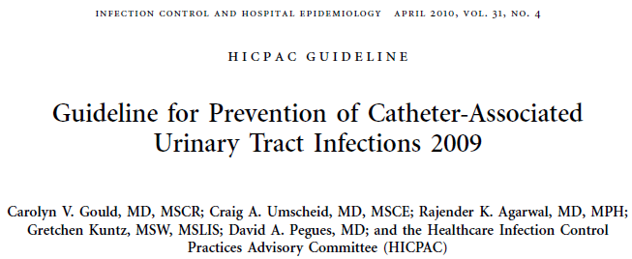
2009 Guideline for Prevention of Catheter-associated Urinary Tract Infections
Full guideline at http://www.cdc.gov/hicpac/index.html

Slide 24
Organization of Recommendations
Appropriate urinary catheter use
Proper techniques for urinary catheter insertion
Proper techniques for urinary catheter maintenance
Quality improvement programs
Administrative infrastructure
Surveillance

Slide 25
Priority Recommendations
Appropriate Urinary Catheter Use
  Insert catheters only for appropriate indications, and leave in place only as long as needed. (Category IB)
    Do not use catheters in patients and nursing home residents for management of incontinence. (Category IB)
    For operative patients who have an indication for an indwelling catheter, remove the catheter as soon as possible, preferably within 24 hours, unless there are appropriate indications for continued use. (Category IB)
Aseptic Insertion of Urinary Catheters
  Ensure that only properly trained persons insert and maintain catheters. (Category IB)
  In acute setting, insert catheters using aseptic technique and sterile equipment.
  (Category IB)
Proper Urinary Catheter Maintenance
  Maintain a sterile, continuously closed drainage system. (Category IB)
25

Slide 26
Indications Table
Table. Examples of appropriate and inappropriate indications for indwelling urethral catheter use
Appropriate indications Acute urinary retention or obstruction Need for accurate measurements of urinary output in critically ill patients Perioperative use for selected surgical procedures: Patients undergoing surgeries of the genitourinary tract Anticipated prolonged duration of surgery Patients anticipated to receive large-volume infusions or diuretics during surgery Need for intraoperative monitoring of urinary output To assist in healing of open sacral or perineal wounds in incontinent patients Patients requires prolonged immobilization (e.g. uncleared thoracic or lumbar spine) To improve comfort for end of life care if needed
Inappropriate indications As a substitute for nursing care in those with incontinence As a means of obtaining urine for culture or other diagnostics when the patient can voluntarily void Prolonged post-operative use without appropriate indications
26

Slide 27
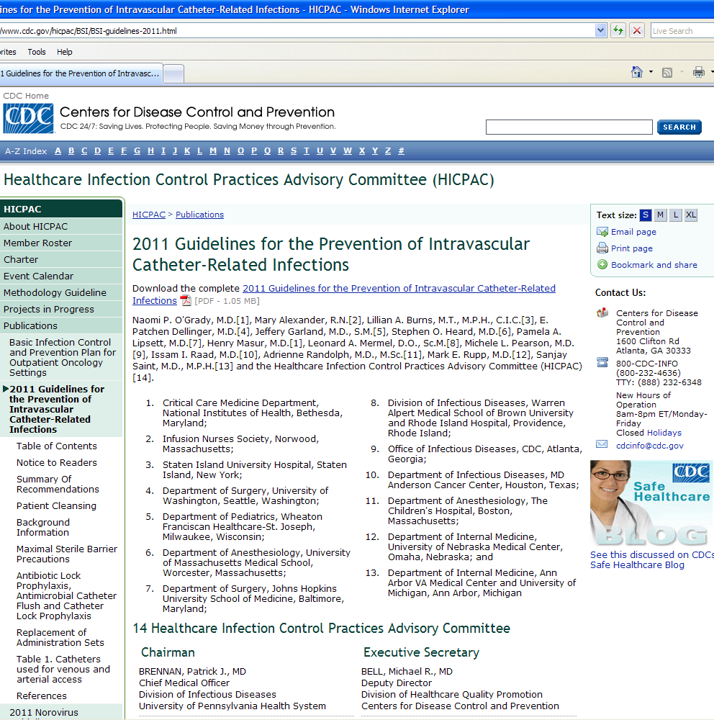
2011 Guideline for the Prevention of Intravascular Catheter-Related Infections
Full guideline at http://www.cdc.gov/hicpac/index.html

Slide 28
Organization of Recommendations
Education, training and staffing
Selection of catheters and sites
Hand hygiene and aseptic technique
Maximum sterile barrier precautions
Skin preparation
Catheter site dressing regimens
Patient cleansing
Catheter securement devices
Antimicrobial/antiseptic impregnated catheters and cuffs
Systemic antibiotic prophylaxis
Antibiotic/antiseptic ointments
Antibiotic lock prophylaxis, antimicrobial catheter flush and catheter lock prophylaxis

Slide 29
Organization of Recommendations (cont)
Anticoagulants
Replacement of catheters
Umbilical catheters
Peripheral arterial catheters and pressure monitoring devices
Replacement of administration sets
Needleless intravascular catheter systems
Performance improvement

Slide 30
Performance improvement bundle literature referenced by CABSI guideline
Eggimann P, Harbarth S, Constantin MN, Touveneau S, Chevrolet JC, Pittet D.Impact of a prevention strategy targeted at vascular-access care on incidence of infections acquired in intensive care. Lancet 2000; 355:1864–8.
Berenholtz SM, Pronovost PJ, Lipsett PA, et al. Eliminating catheter-related bloodstream infections in the intensive care unit. Crit Care Med 2004; 32:2014–20.
Frankel HL, Crede WB, Topal JE, Roumanis SA, Devlin MW, Foley AB. Use of corporate Six Sigma performance-improvement strategies to reduce incidence of catheter-related bloodstream infections in a surgical ICU. J Am Coll Surg 2005; 201:349–58.
Pronovost P, Needham D, Berenholtz S, et al. An intervention to decrease catheter-related bloodstream infections in the ICU. N Engl J Med 2006; 355:2725–32.
Costello JM, Morrow DF, Graham DA, Potter-Bynoe G, Sandora TJ, Laussen PC. Systematic intervention to reduce central line-associated bloodstream infection rates in a pediatric cardiac intensive care unit. Pediatrics 2008; 121:915–23.
Galpern D, Guerrero A, Tu A, Fahoum B, Wise L. Effectiveness of a central line bundle campaign on line-associated infections in the intensive care unit. Surgery 2008; 144:492–5.
McKee C, Berkowitz I, Cosgrove SE, et al. Reduction of catheter-associated bloodstream infections in pediatric patients: experimentation and reality. Pediatr Crit Care Med 2008; 9:40–6.

Slide 31
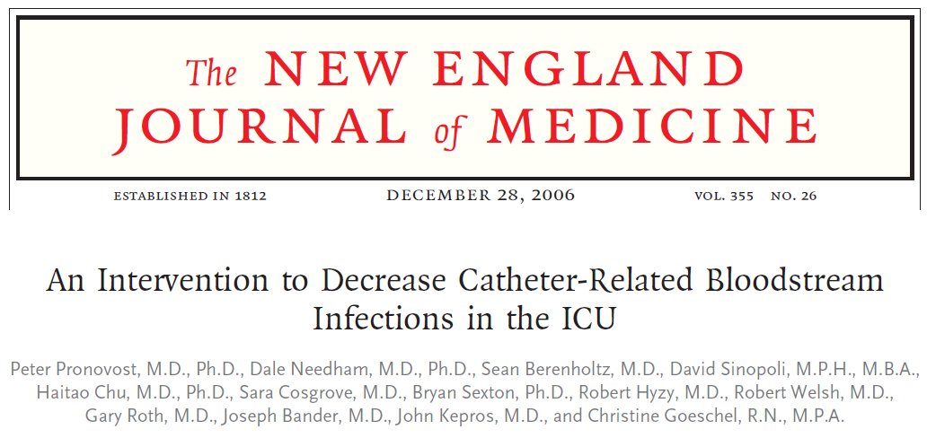

Slide 32
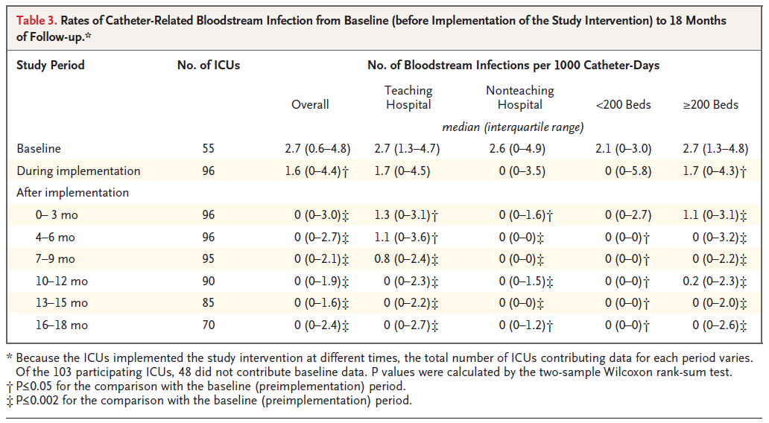

Slide 33
Pronovost CABSI bundle
Hand hygiene
Maximum barrier precautions
Chlorhexidine site disinfection
Avoiding the femoral site
Promptly removing unnecessary central venous catheters

Slide 34
CABSI bundles (continued)
Educating staff about CABSI prevention
Central venous catheter cart that contained all the necessary supplies
Prompt removal of unnecessary central catheters identified during daily patient rounds
Checklist to ensure adherence to proper practices
Stoppage of procedures in non-emergent situations, if evidence- based practices were not being followed
Feedback to the clinical teams regarding the number of CRBSI episodes and overall rates
Buy-in from the CEO of the participating hospitals that chlorhexidine gluconate products/solutions would be stocked

Slide 35
CDC Prevention of SSI Guideline – Update of 1999 Guideline
CORE Questions
Antimicrobial prophylaxis
Glycemic control
Normothermia
Tissue oxygenation
Skin preparation
S. aureus colonization
Surgical checklists
Bundles
16 Key Questions
ARTHROPLASTY Questions
Transfusion
Immunosuppression
Anticoagulation
Surgical attire
Surgical technique
Anesthesia
Environmental
Biofilm
22 Key questions

Slide 36
Expert Panel & Core Writing Group
University of Pennsylvania Center for Evidence-based Practice
American College of Surgeons (ACS)
American Academy of Orthopaedic Surgeons (AAOS)
Association of periOperative Registered Nurses (AORN)
CDC/HICPAC
SSI Guideline Content Experts
Core Writing Group
Musculoskeletal Infection Society (MSIS)
HICPAC
Leads
Surgical Infection Society (SIS)
European Union
HICPAC , Liaison & Ex-officio members
Academic Institutions
S. aureus , Biofilm, Environmental
External and CDC
CDC
Lead

Slide 37
Core Writing Group
HICPAC Committee
Dale W. Bratzler, DO, MPH
William P. Schecter, MD
Center for Evidence-based Practice, U Penn
Craig Umscheid MD, MSCE , FACP
Rachel Kelz, MD , MSCE, FACS
Caroline Reinke, MD, MPH
Brian Leas, MA, MS
Sherry Morgan, RN, MLS, PhD
Centers for Disease Control and Prevention
Sandra I. Berríos-Torres, MD

Slide 38
Content Experts
American Academy of Orthopaedic Surgeons (AAOS)
Javad Parvizi ,MD
John Segreti, MD
American College of Surgeons (ACS)
E. Patchen Dellinger, MD
Association of periOperative Registered Nurses (AORN)
Joan Blanchard, MSS, BSN, RN, CNOR, CIC
George Allen, PhD, CIC, CNOR
Musculolskeletal Infection Society (MSIS)
Elie Berbari, MD
Douglas Osmon, MD
Surgical Infection Society (SIS)
Lena M. Napolitano, MD, FACS, FCCP, FCCM
Kamal Itani, MD
Robert Sawyer, MD
Academic Institutions
Jan A.J.W. Kluytmans, MD (Amphia Hospital, The Netherlands)
John E. Mazuski, MD, PhD (Washington University, St. Louis)
Bernard Morrey, MD (The Mayo Clinic)
Joseph Solomkin, MD (U of Cincinnati)
Staphylococcus aureus (SA) Colonization
Lonneke G.M. Bode ,MD (Erasmus University, The Netherlands)
Susan Huang, MD (U of California, Irvine)
Jan A.J.W. Kluytmans, MD (Amphia Hospital, The Netherlands)
Ari Robicsek, MD (Northshore University Health System)
Mark Shirtliff, PhD (University of Maryland)
Margreet Voz, MD (Erasmus University, The Netherlands)
Jeff Hageman, MHS (CDC)
John A. Jernigan, MD, MS (CDC)
Alex Kallen MD, MPH (CDC)
Biofilm
William Costerton, PhD (Center for Genomic Sciences)
Robin Patel, MD (Mayo Clinic)
Mark Shirtliff, PhD (University of Maryland)
Rodney Donlan, PhD (CDC)
Environmental
Lynne Sehulster, PhD (CDC)

Slide 39
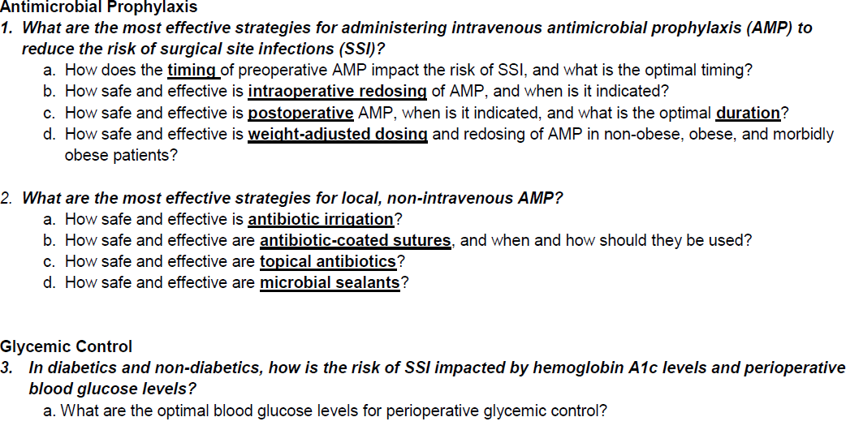
Key Questions - CORE

Slide 40
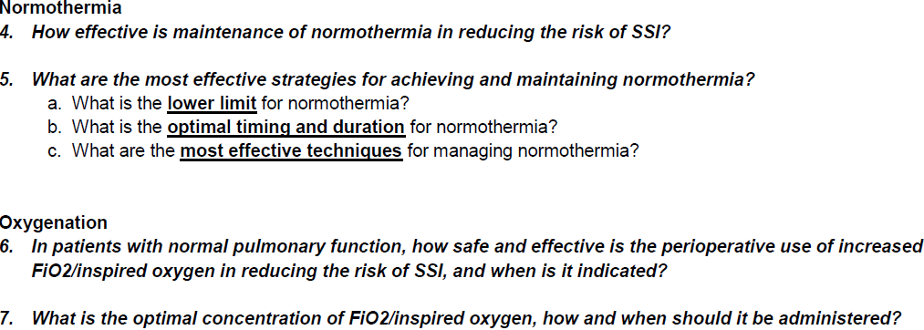
Key Questions - CORE

Slide 41

Key Questions - CORE

Slide 42
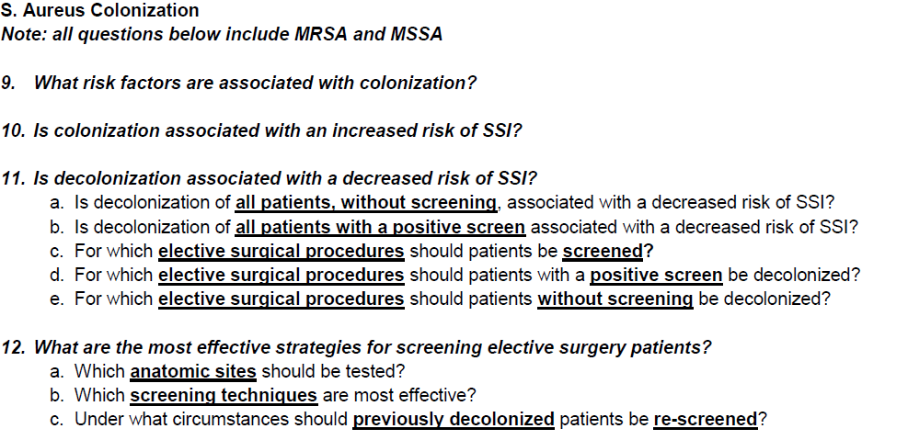
Key Questions - CORE

Slide 43
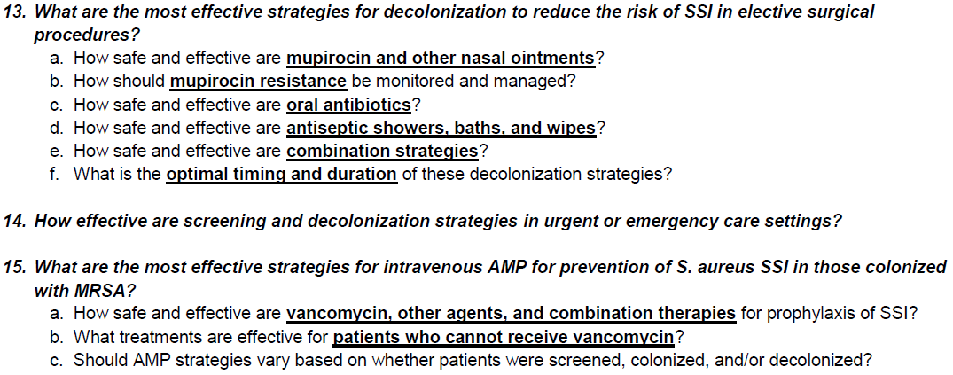
Key Questions - CORE

Slide 44
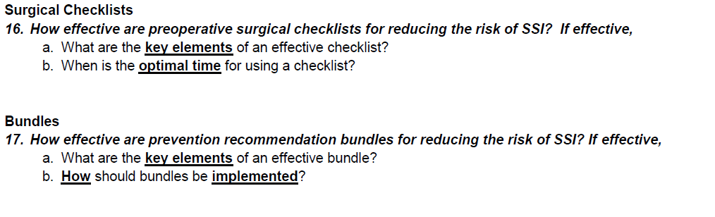
Key Questions - CORE

Slide 45
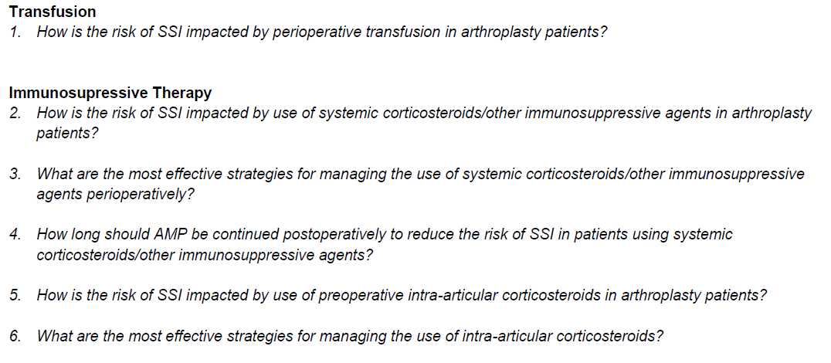
Key Questions - ARTHROPLASTY

Slide 46
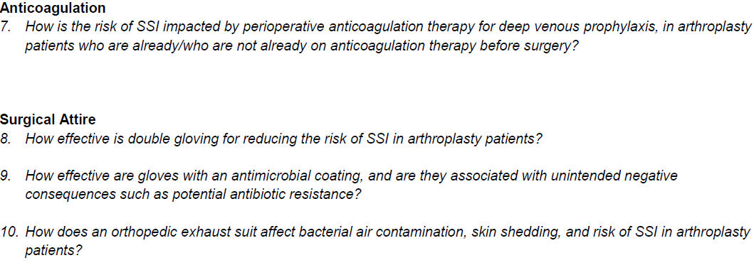
Key Questions - ARTHROPLASTY

Slide 47
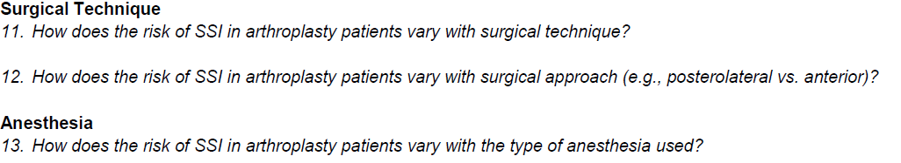
Key Questions - ARTHROPLASTY

Slide 48
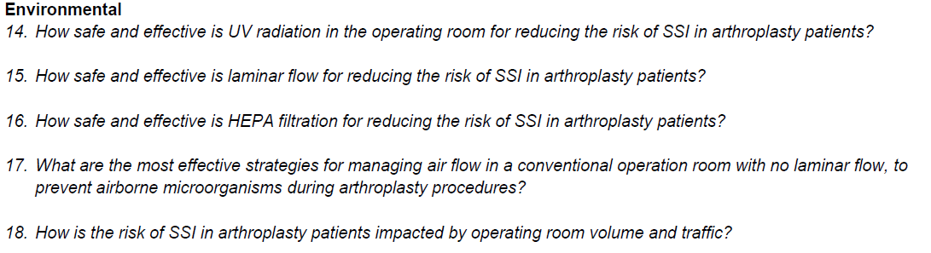
Key Questions - ARTHROPLASTY

Slide 49
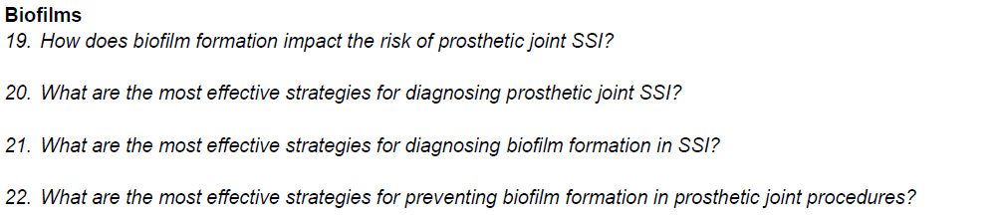
Key Questions - ARTHROPLASTY

Slide 50
SSI Guideline
Timeline
Arthroplasty Literature Search (sample)
Arthroplasty Title/Abstract Screen
Broad SSI Literature Search
CORE Literature Search (sample)
Content Experts Core Writing Group
CORE Title/Abstract Screen
HICPAC Presentation
Final Key Questions
Preliminary Questions
Guideline Structure
Final Key Topics
Guideline Review
Preliminary Topics
NEXT STEPS
2010
2011
2012
June
Dec
June
Dec
Feb
Apr
June
Preliminary Bibliography
Full Text Review
Targeted Literature Searches
Extraction Finalized
GRADE
Narrative summaries
Post to Federal Register
SSI slides courtesy of
Sandra I. Berríos-Torres, MD
CDC

Slide 51
SSI prevention practices from studies included in our review on HAI preventability
Appropriate use of perioperative antibiotics
Decreased use of preoperative shaving
Improvement in perioperative glucose control
Clinician education and reminders
Patient education
Audit and feedback
Dellinger EP, Hausmann SM, Bratzler DW, et al. Hospitals collaborate to decrease surgical site infections. Am J Surg. 2005;190(1):9-15.
Lutarewych M, Morgan SP, Hall MM. Improving outcomes of coronary artery bypass graft infections with multiple interventions: Putting science and data to the test. Infect Control Hosp Epidemiol. 2004;25(6):517-9.
Rao N, Schilling D, Rice J, Ridenour M, Mook W, Santa E. Prevention of postoperative mediastinitis: A clinical process improvement model. J Healthc Qual. 2004;26(1):22-7.

Slide 52
Conclusions
In those settings examined, reductions in HAIs have never achieved 100%, even with evidence-based infection control strategies
Even though 100% preventability may not be attainable, evidence-based infection control strategies could prevent hundreds of thousands of HAIs, and save tens of thousands of lives and billions of dollars
Evidence-based guidelines are available that provide syntheses of the research literature and resulting recommendations to guide our infection prevention efforts
Translating these evidence-based recommendations and bundles into practice to prevent infections is the work of all of us here today

Slide 53
Key References
Umscheid CA, Mitchell MD, Doshi JA, Agarwal R, Williams K, Brennan PJ. Estimating the proportion of healthcare-associated infections that are reasonably preventable and the related mortality and costs. Infect Control Hosp Epidemiol. 2011; 32(2):101-14.
Klevens RM, Edwards JR, Richards CL, Jr, et al. Estimating healthcare-associated infections and deaths in US hospitals, 2002. Public Health Rep. 2007 Mar-Apr; 122(2): 160-6.
Ranji SR, Shetty K, Posley KA, et al. Volume 6 - prevention of healthcare-associated infections. Rockville, MD: Agency for Healthcare Research and Quality; 2007 January. Report No.: AHRQ Publication No. 04(07-0051-6.
Scott RD. The direct medical costs of healthcare-associated infections in US hospitals and the benefits of prevention. Available at: http://www.cdc.gov/ncidod/dhqp/pdf/scott_costpaper.pdf. Accessed July 3, 2011.
Pronovost PJ, Goeschel CA, Wachter RM. The wisdom and justice of not paying for "preventable complications." JAMA. 2008; 299(18):2782-4.
Gould CV, Umscheid CA, Agarwal RK, Kuntz G, Pegues DA, and the Healthcare Infection Control Practices Advisory Committee. Guideline for the Prevention of Catheter-Associated Urinary Tract Infections, 2009. Available at: http://www.cdc.gov/hicpac/cauti/001_cauti.html. Accessed July 3, 2011.
O'Grady NP, Alexander M, Burns LA, et. al. 2011 Guidelines for the Prevention of Intravascular Catheter-Related Infections. Available at: http://www.cdc.gov/hicpac/BSI/BSI-guidelines-2011.html. Accessed July 3, 2011.
Pronovost PJ, et. al. An intervention to decrease catheter-related blood stream infections in the ICU. NEJM. 2006; 355(26): 2725-32.
Compendium of strategies to prevent healthcare-associated infections in acute care hospitals. Available at: http://www.shea-online.org/GuidelinesResources/CompendiumofStrategiestoPreventHAIs.aspx. Accessed July 3, 2011.
IHI Improvement Map. Available at: http://www.ihi.org/IHI/Programs/ImprovementMap/ImprovementMap.htm?TabId=0. Accessed July 3, 2011.
The Joint Commission. National Patient Safety Goals. Available at: http://www.jointcommission.org/standards_information/npsgs.aspx. Accessed July 3, 2011.

Slide 54

Discussion
http://www.uphs.upenn.edu/cep/

